Slide 2
MISSION
Community Living in Mississippi – Baddour (CLIMB) provides supports for people with intellectual and developmental disabilities so that they can be informed, engaged, and vibrant parts of their community.
We will plan with persons rather than for them based on their wants and needs and picture of an ideal life.

Slide 3
What services are available?
1915c – IDD Waiver
1915i CSP Services
Day Services – Adult
Supervised Living Services
Supported Living Services

Slide 4
Day Services – Adult
CLIMB shall offer a Day Services—Adult (DSA) Program to people living in the community.
In a setting separate from each person’s living arrangement
Located in the community, allowing access to activities such as shopping, eating, parks, etc.
On a regular basis and include both group and individual participation in activities.
Intended to enhance daily living and other skills, improve decision-making, a greater confidence in community settings, and more meaningful days for each person

Slide 5
DMH Certifications
Certified for DSA…January 2018 - December 2020
Opened program September 4, 2018
DSA Open House March 21, 2019
Certified for Supervised Living …May 2019 -December 2020
Opened Home on July 1, 2019
Certified for Supported Living…June 2019-December 3,2019
Opened service on July 1, 2019 in supervised living home

Slide 6
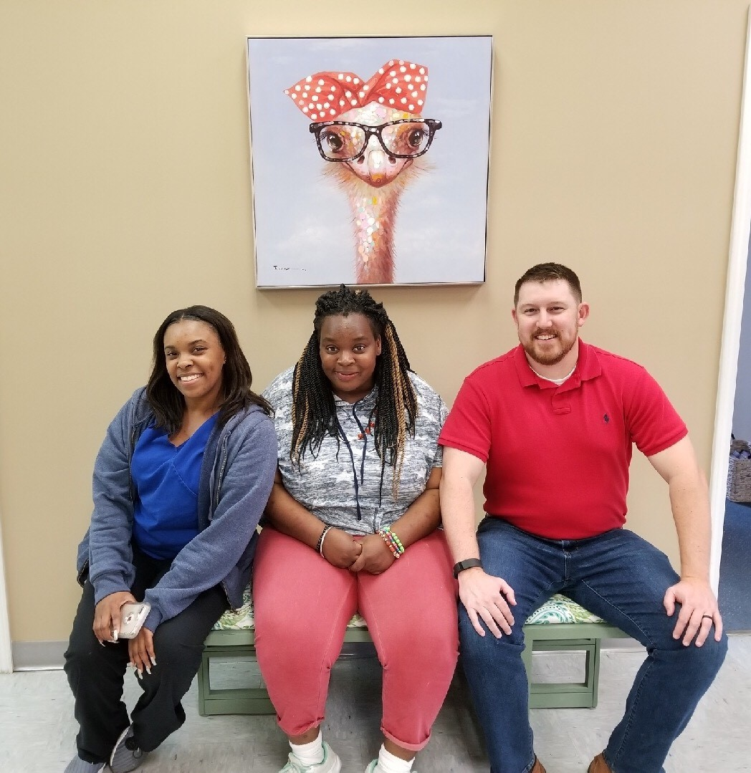
DSA Opened on 9/4/2018
CLIMB officially opened its doors providing an Adult Day Services program on Tuesday, September 4, 2018 with one female participant.

Slide 7
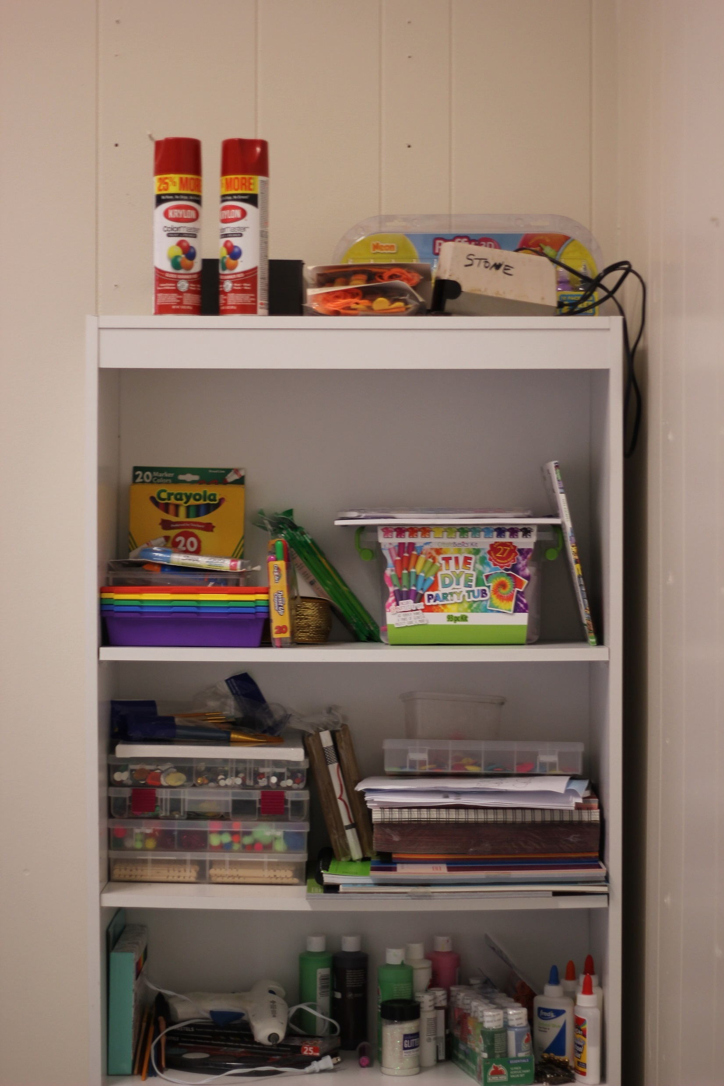
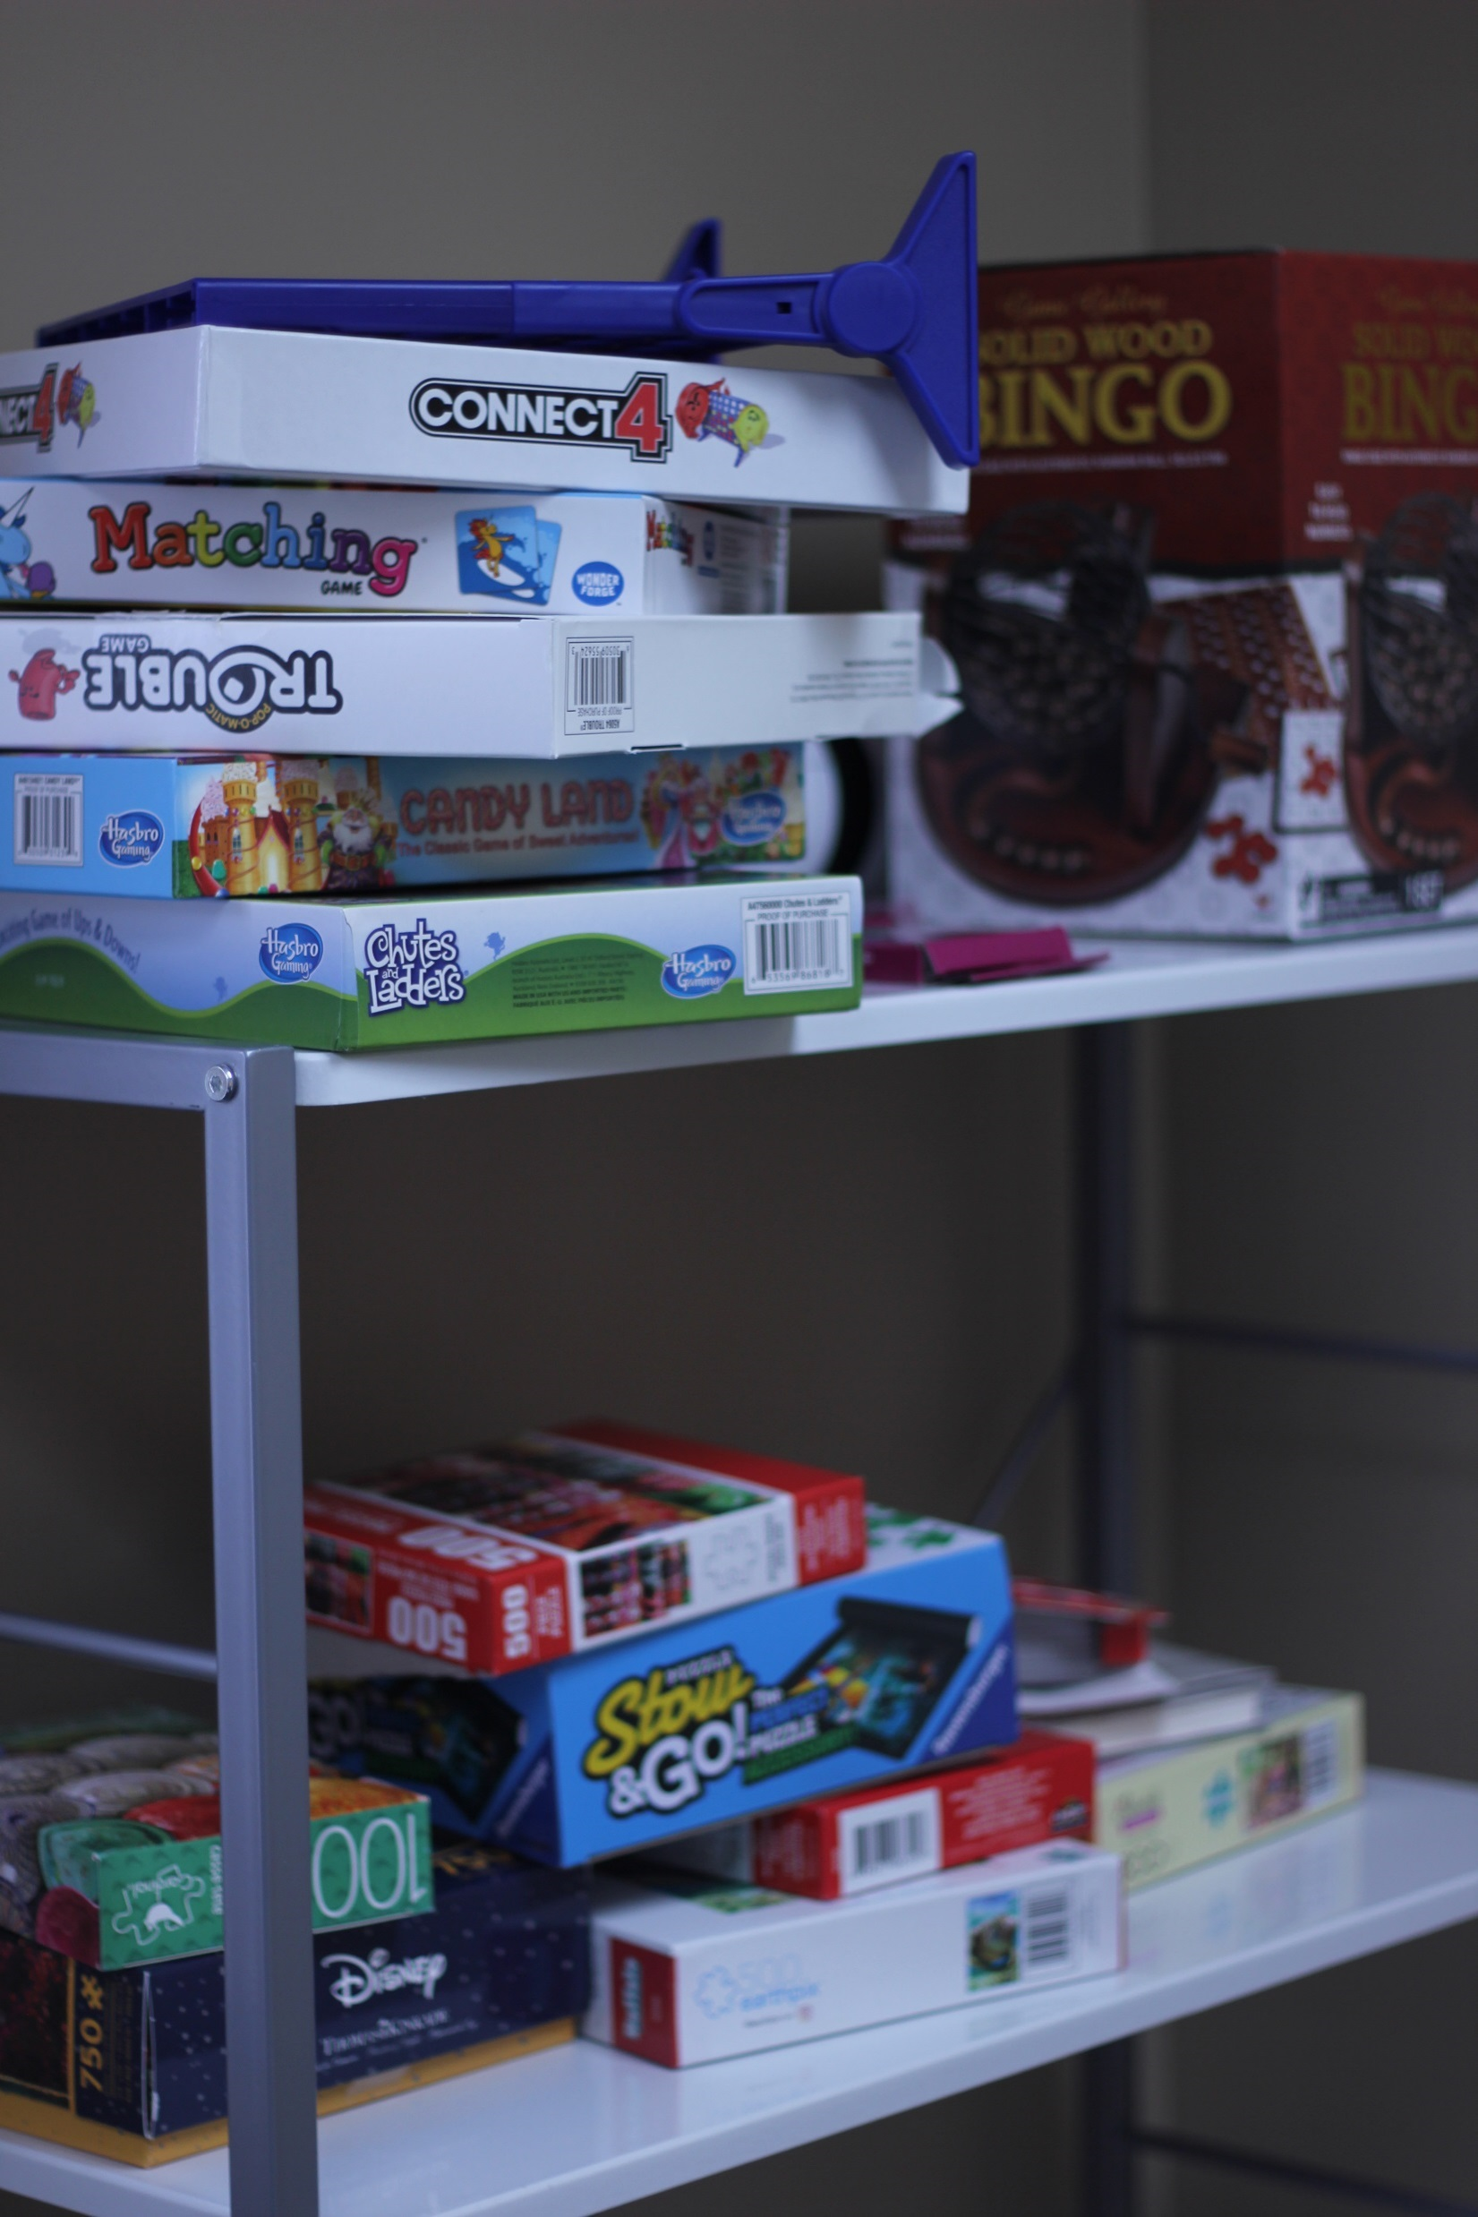
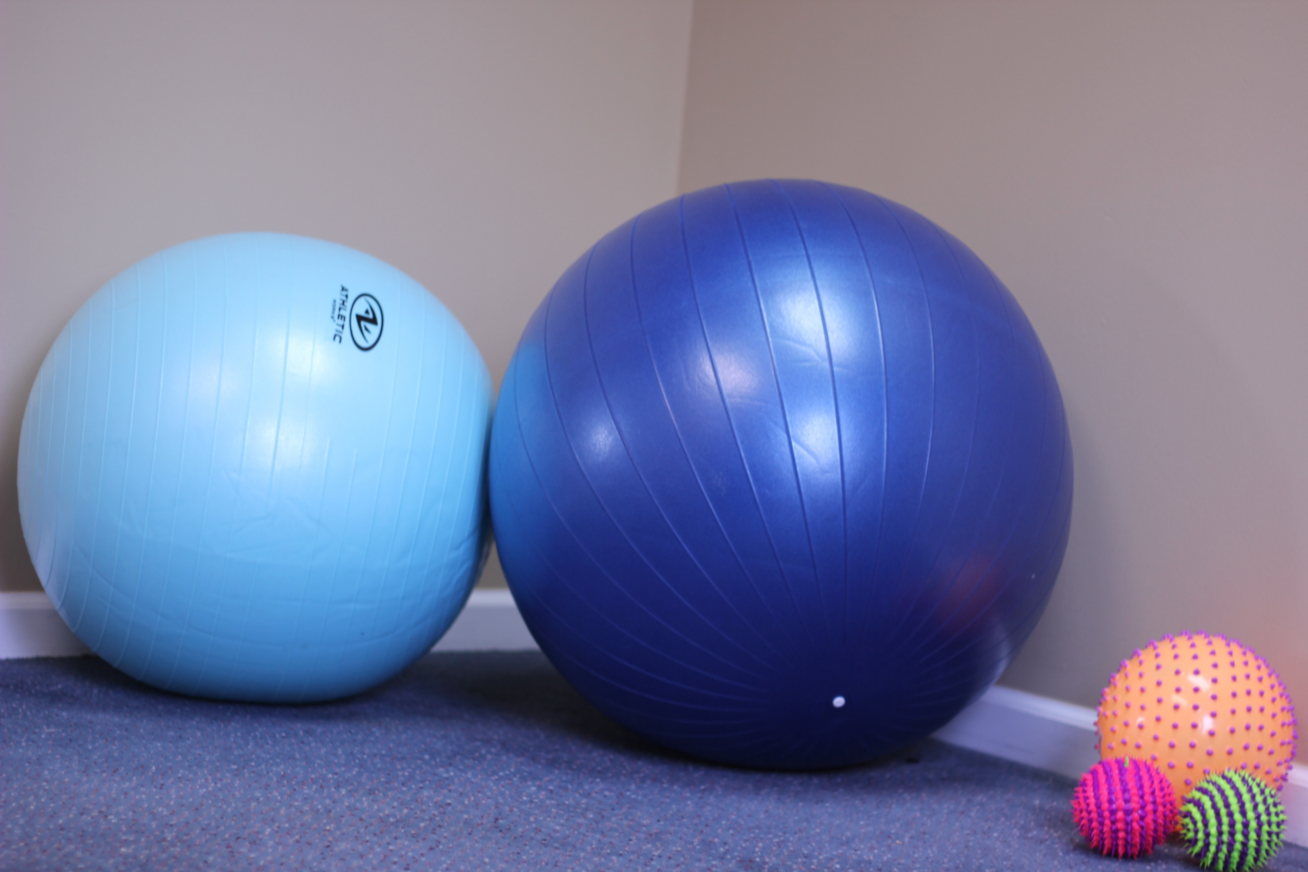
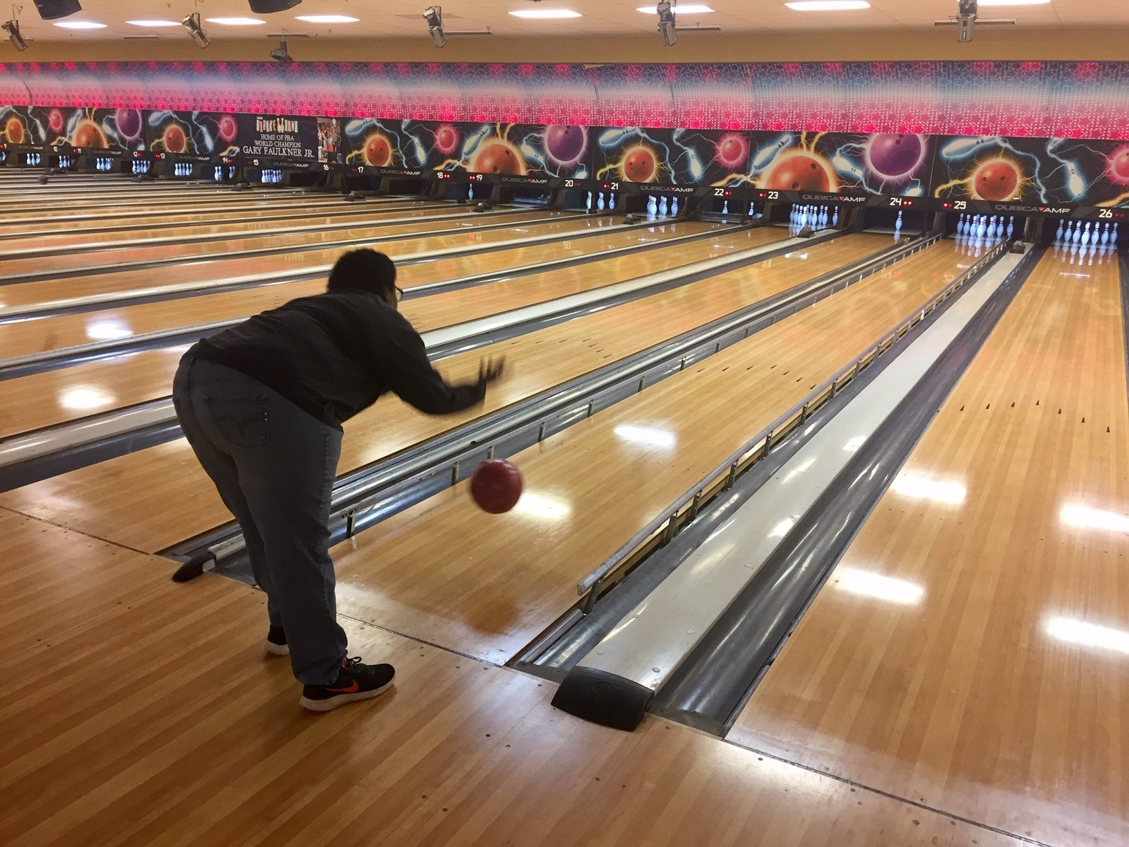
…And the fun begins!

Slide 8
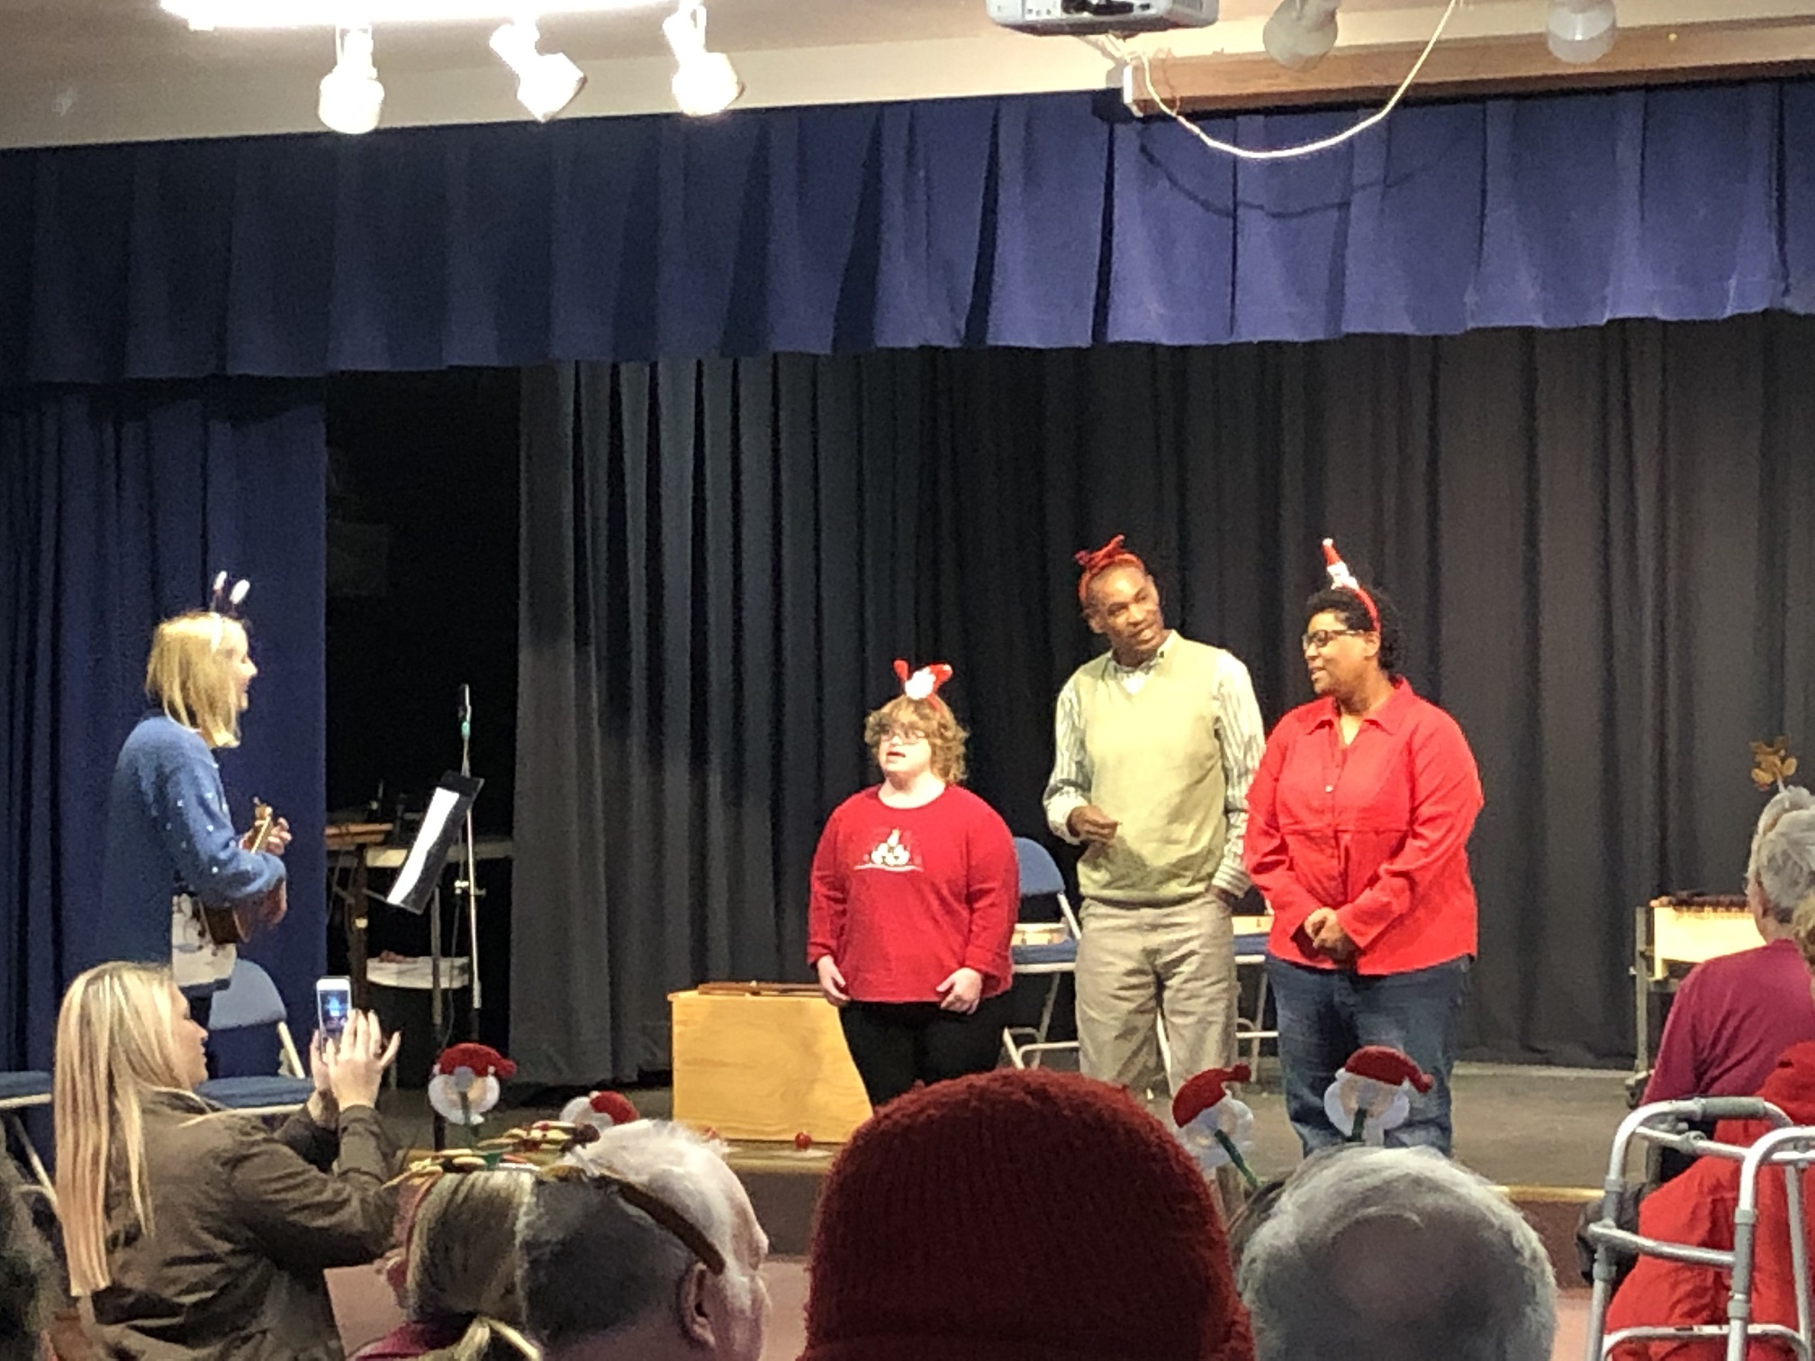
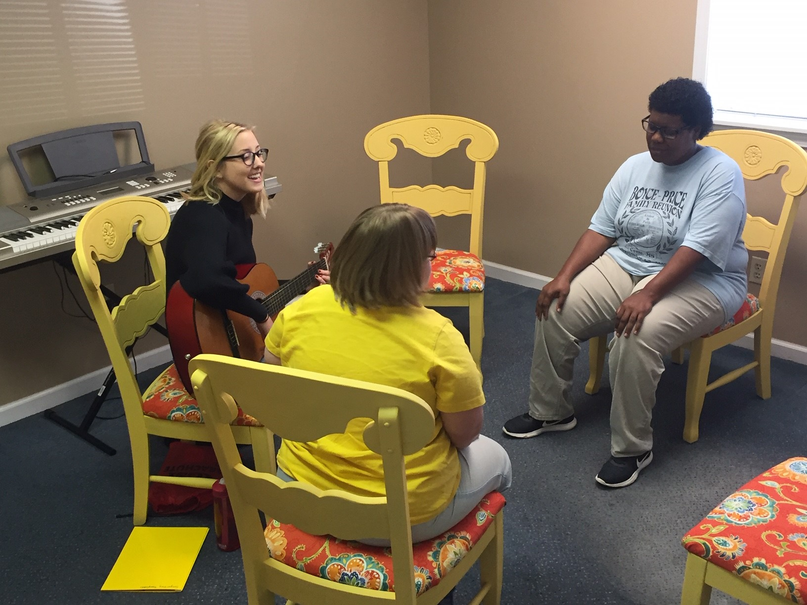
WE LOVE MUSIC

Slide 9
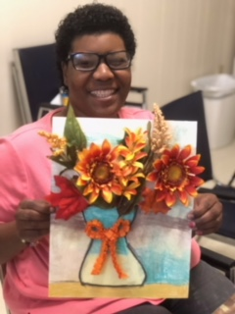
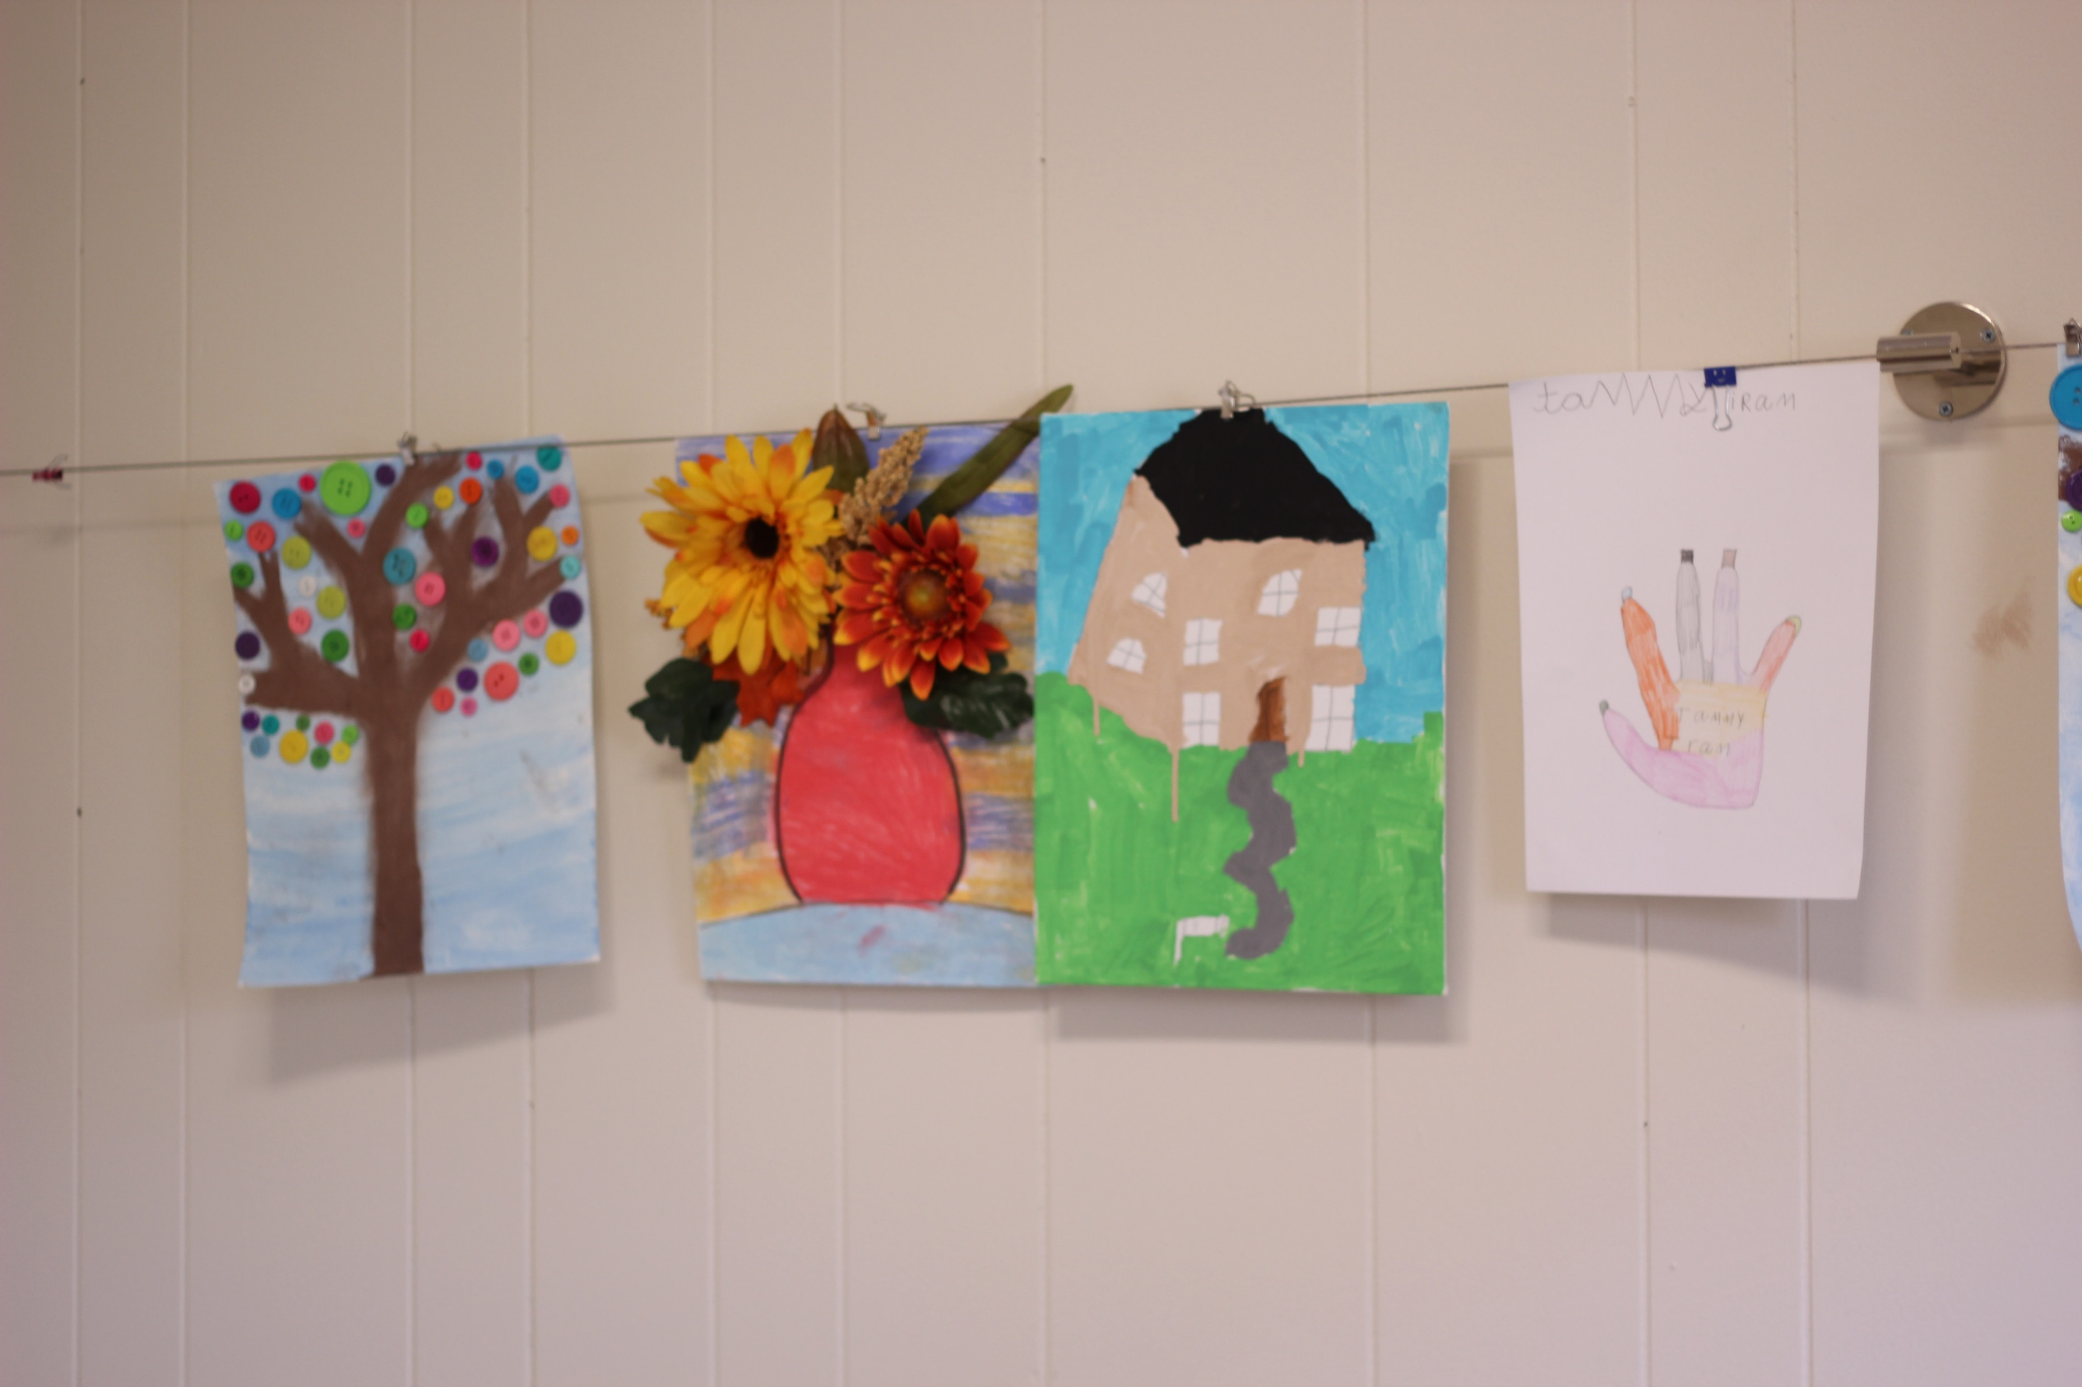
DSA ART Activities

Slide 10
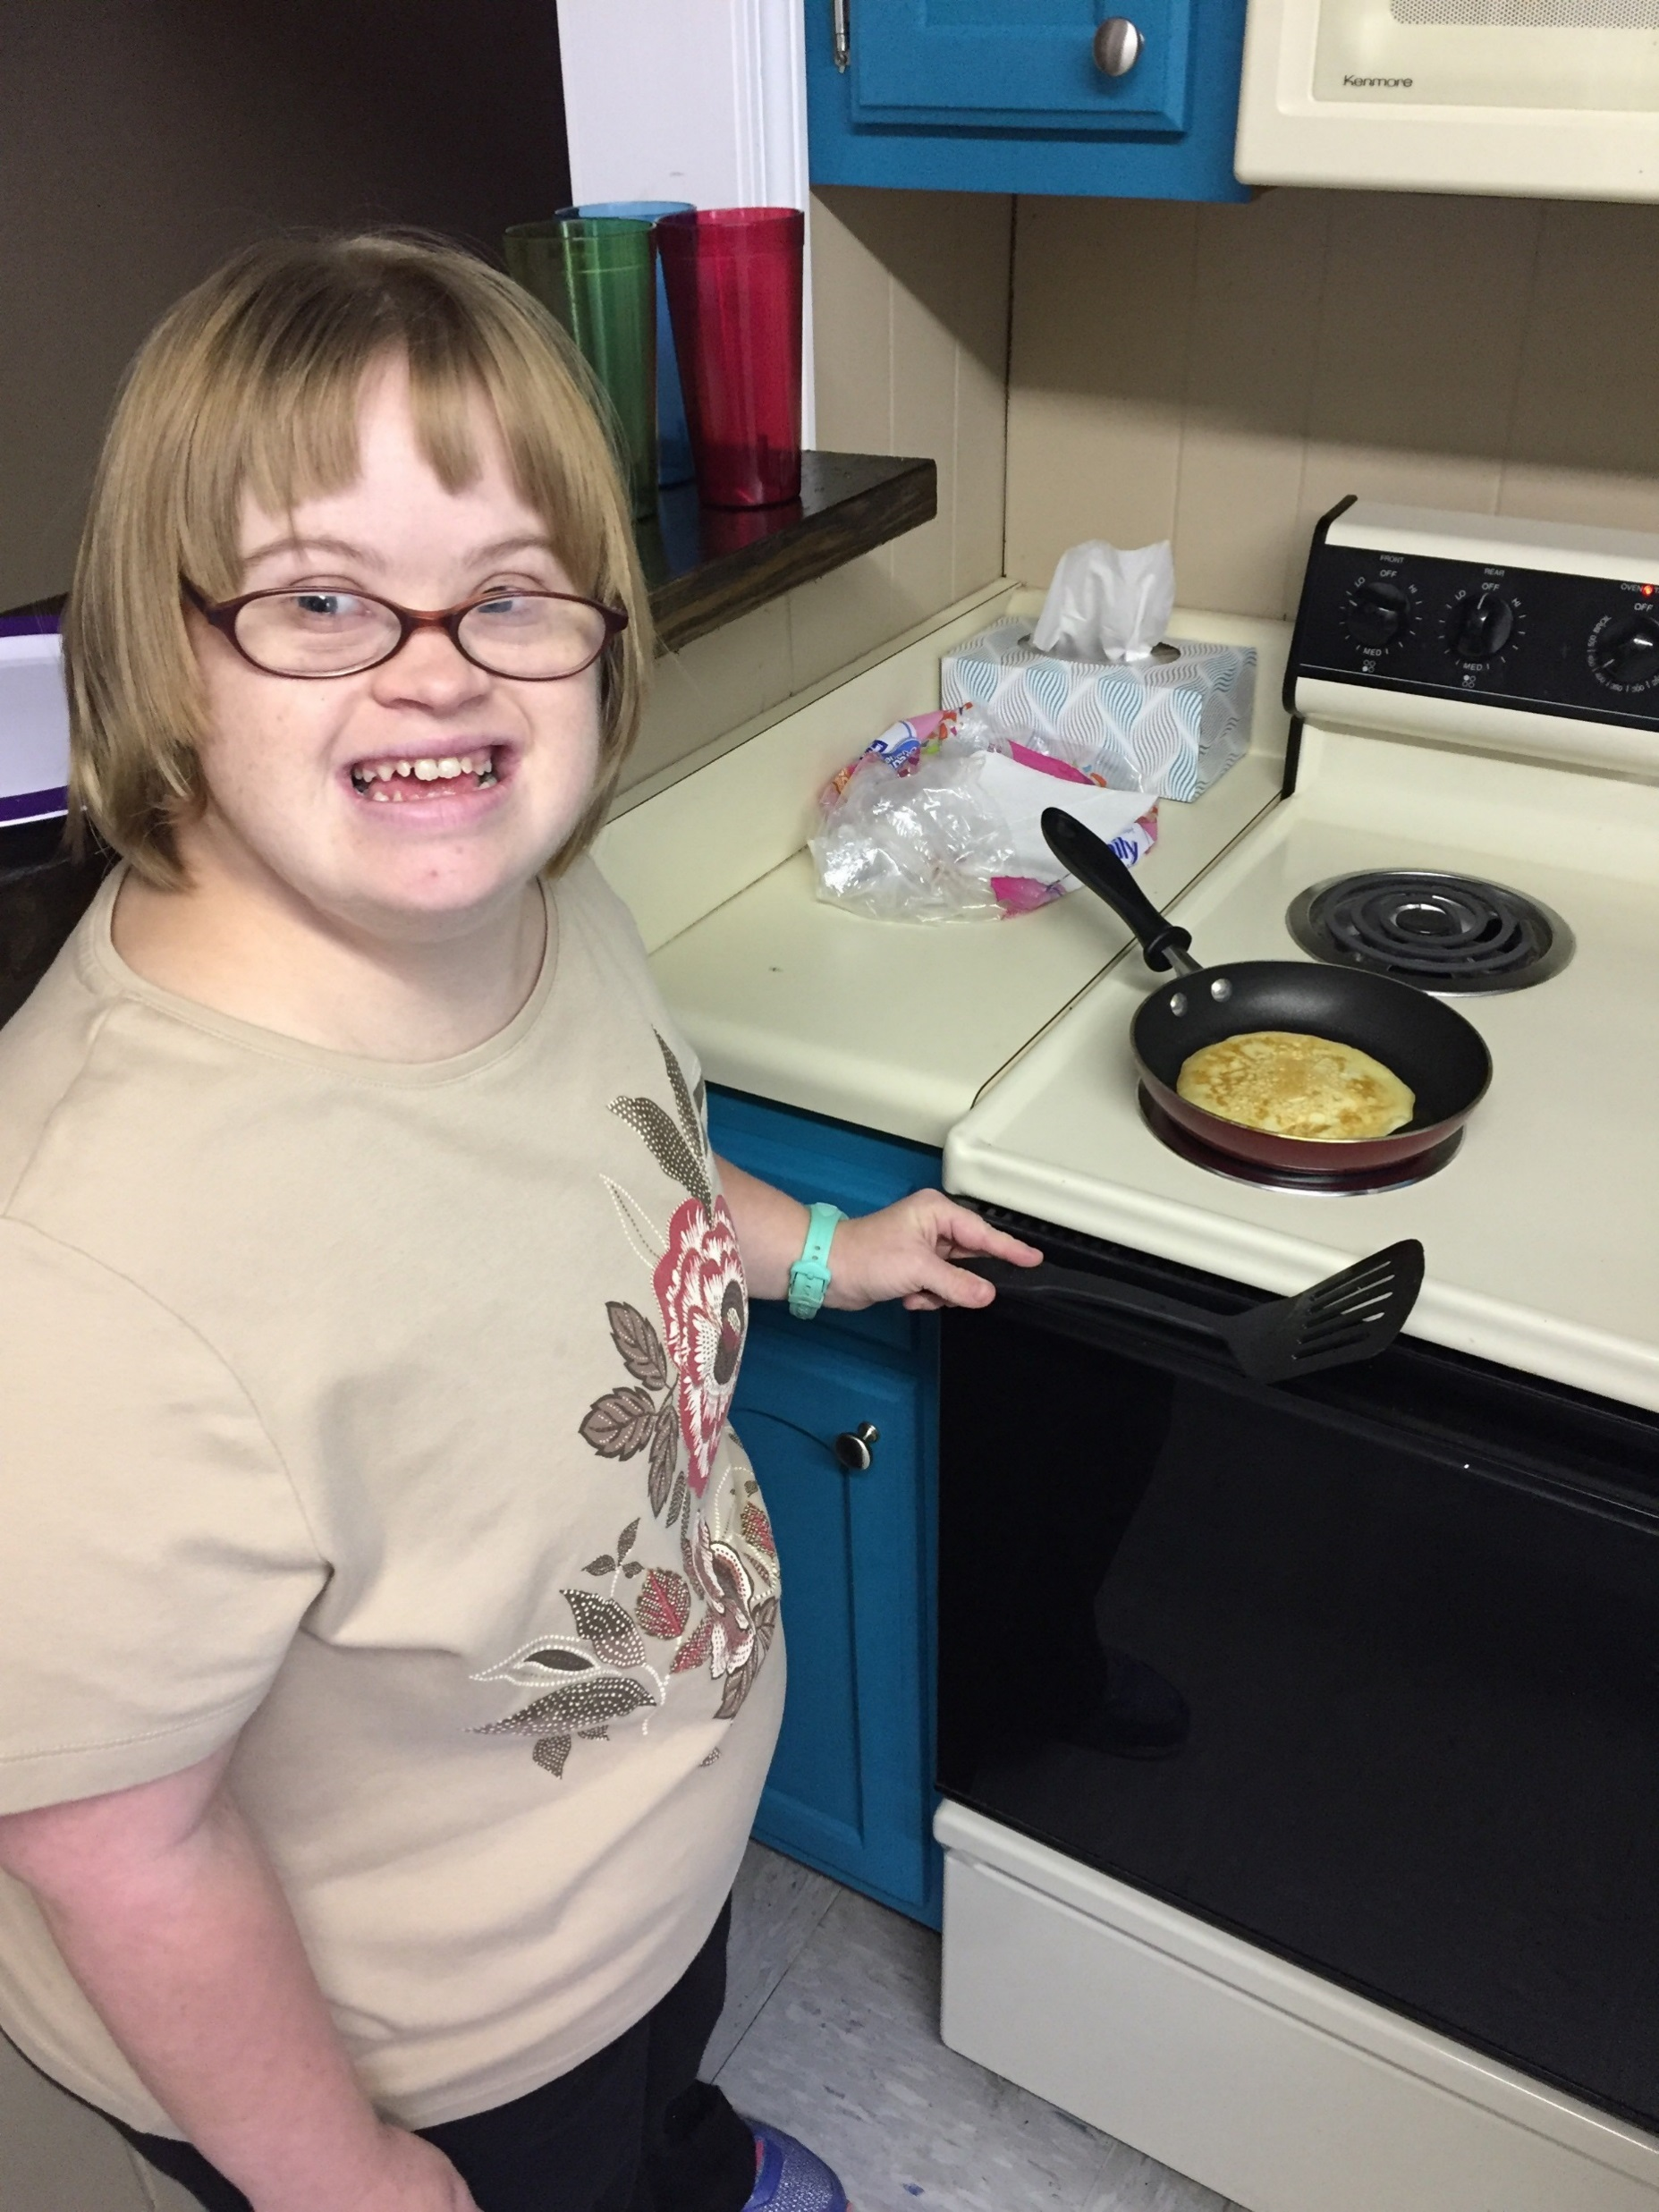
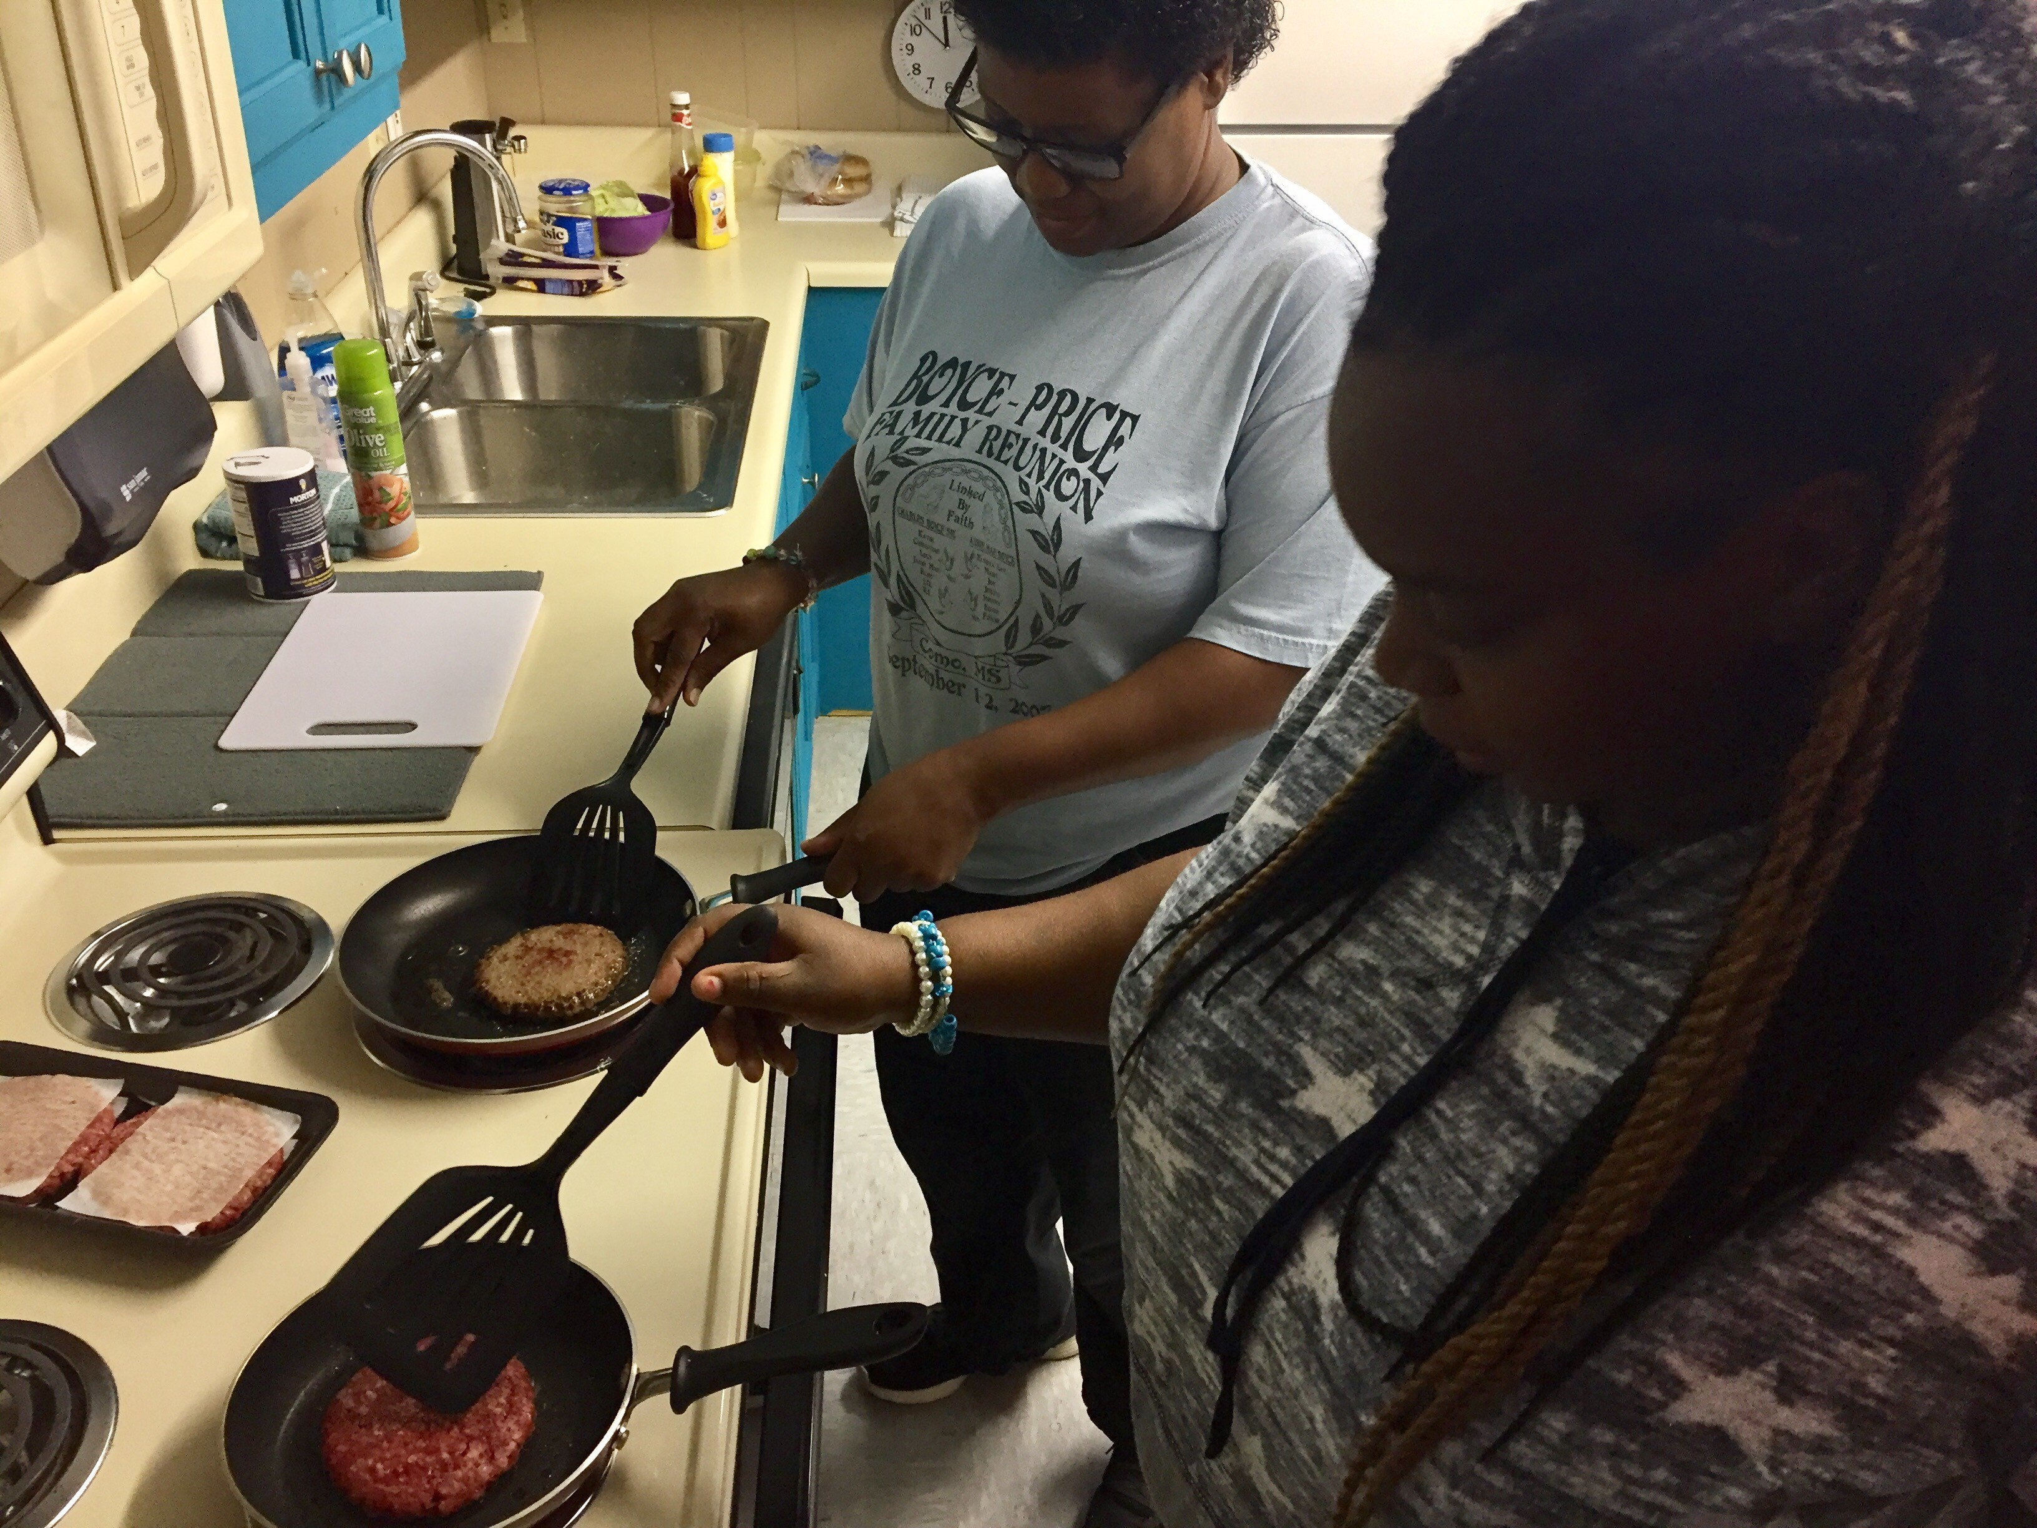
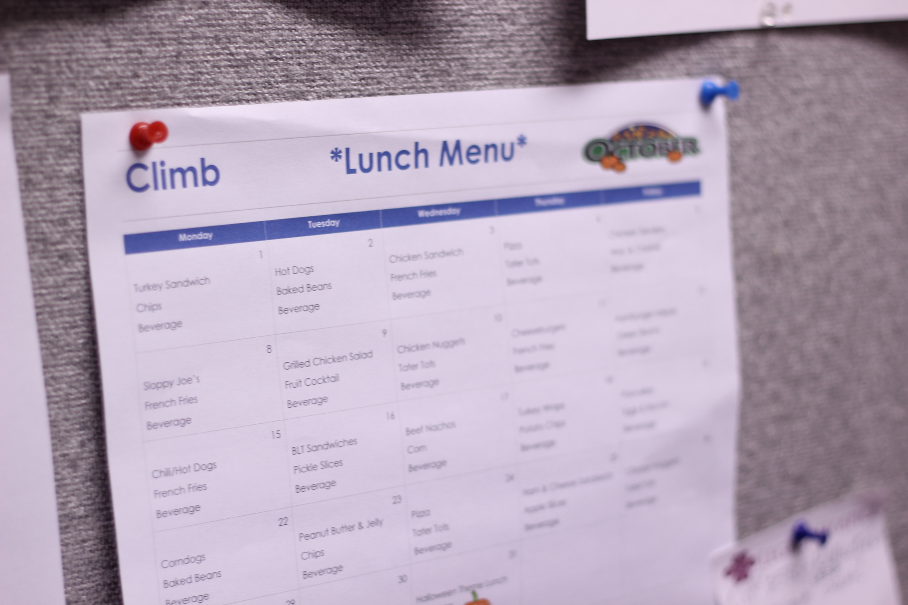
DSA COOKING Activities

Slide 11
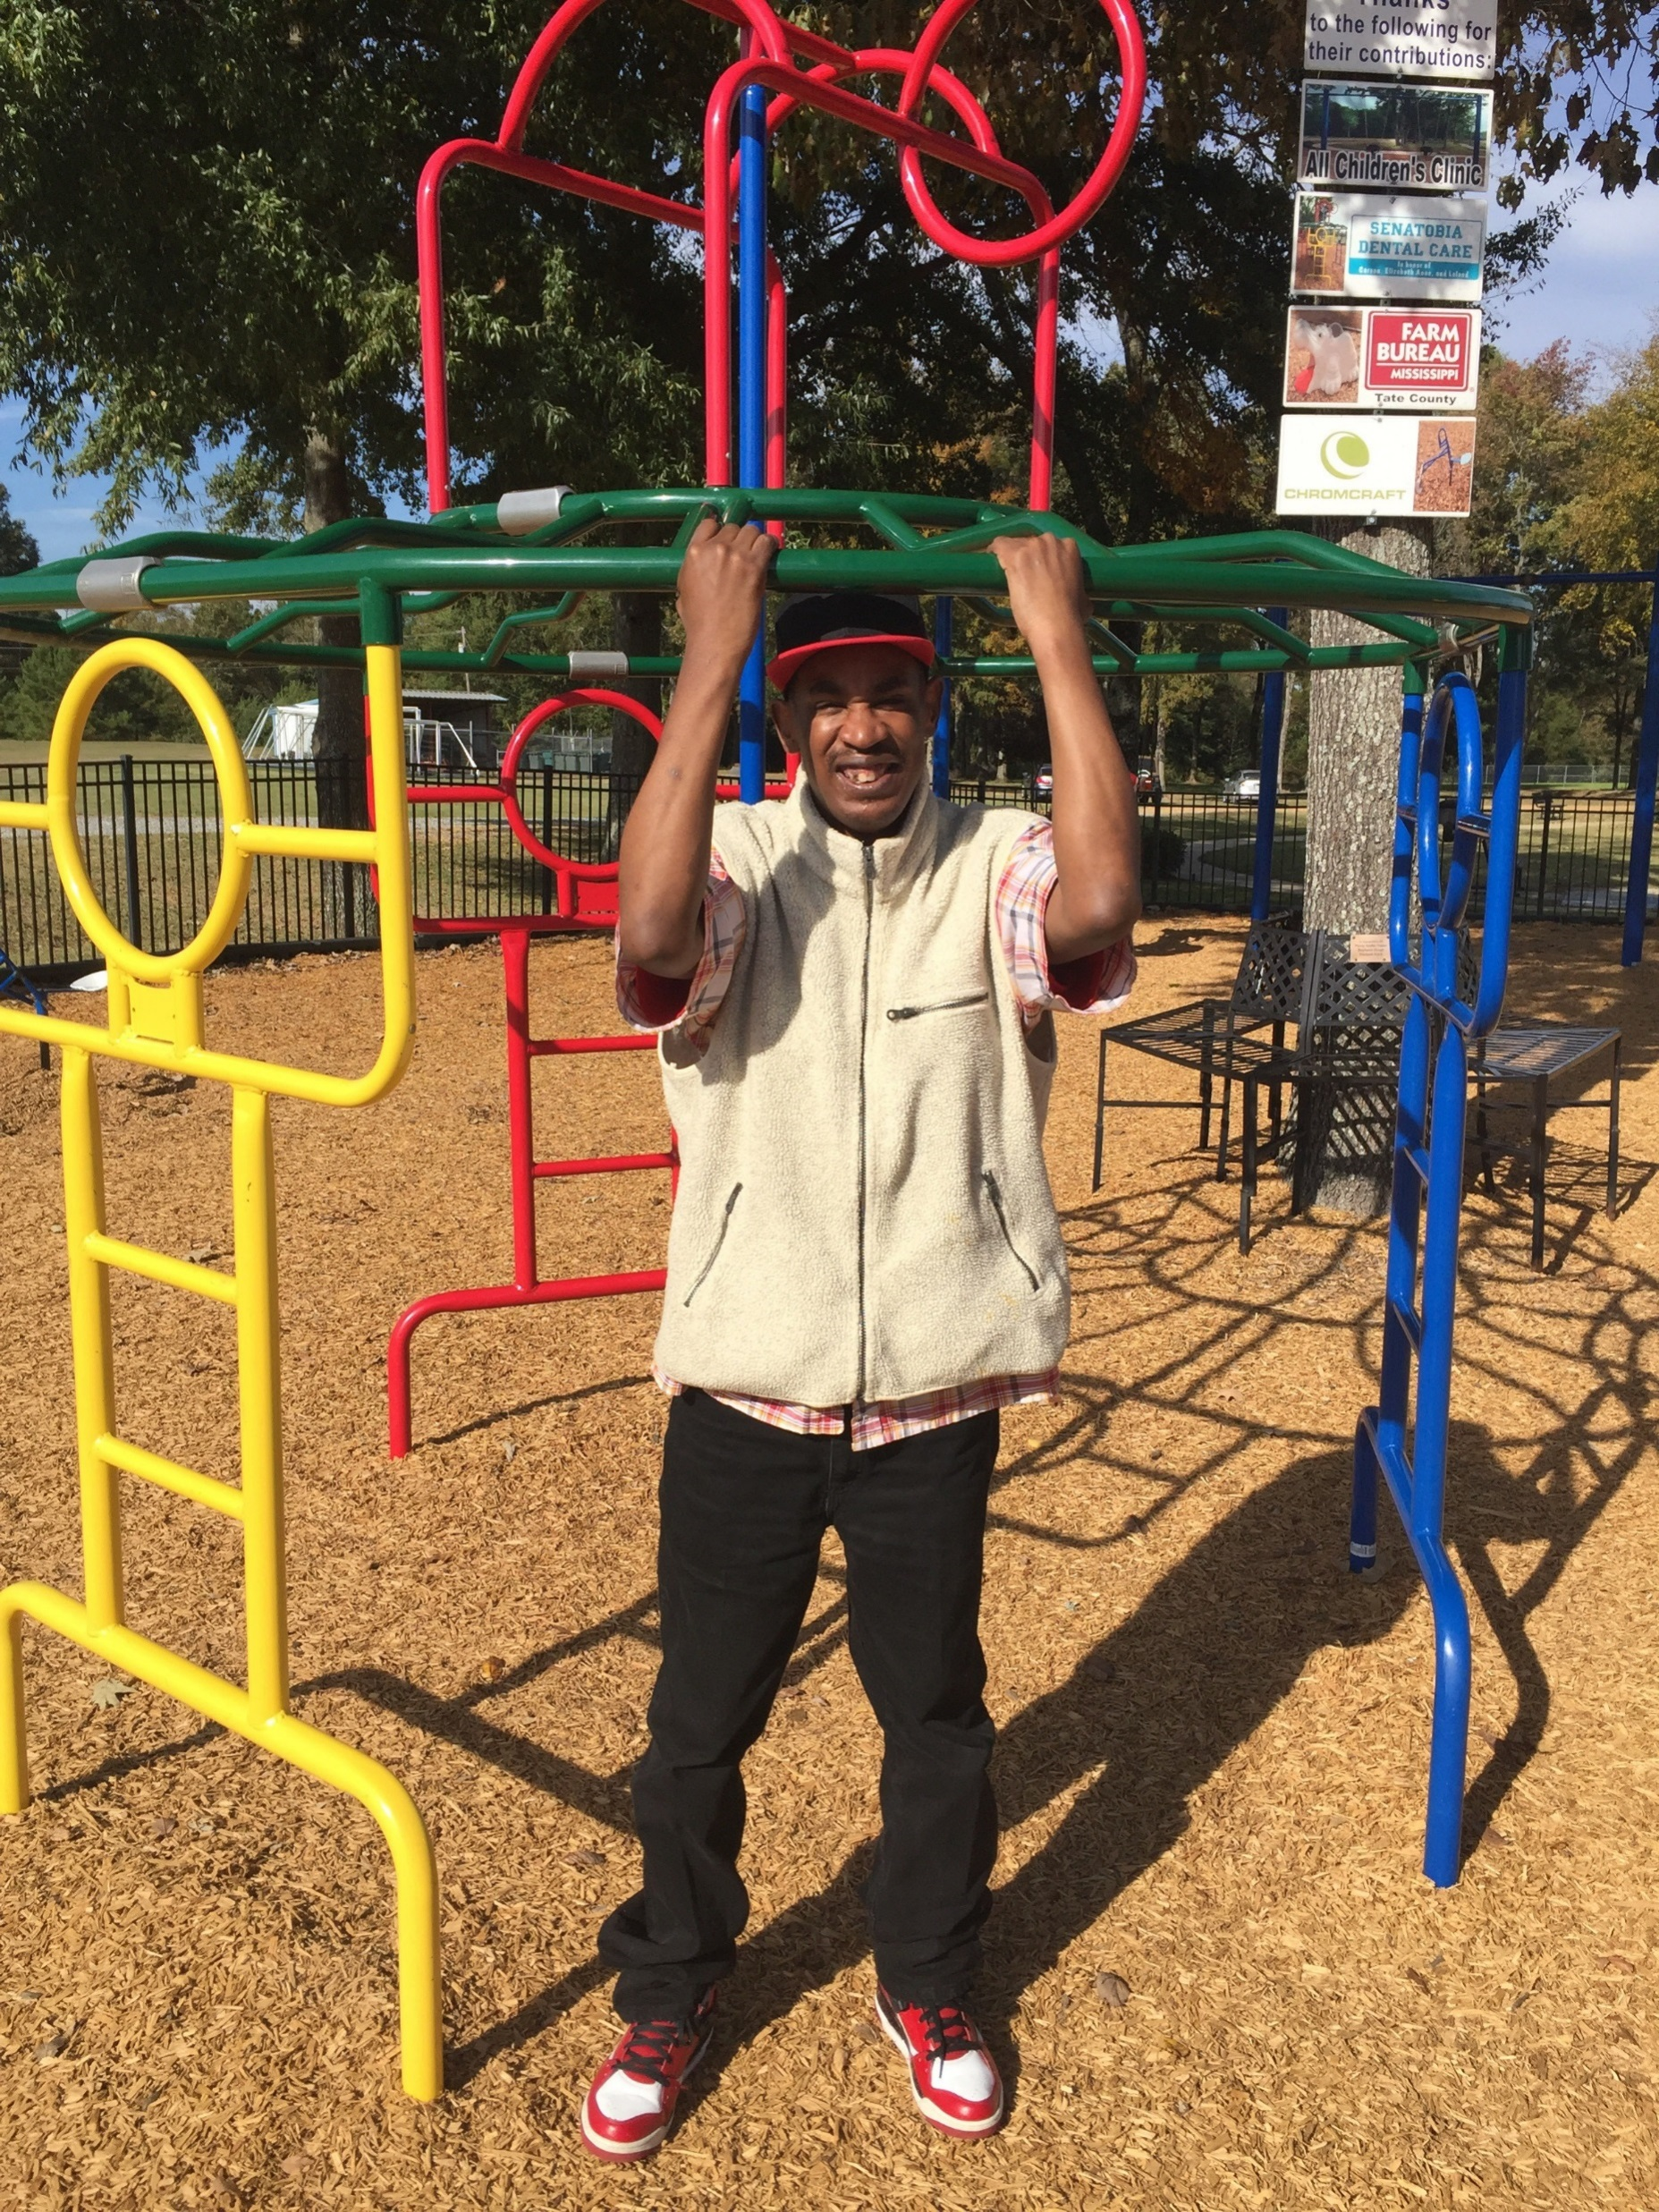
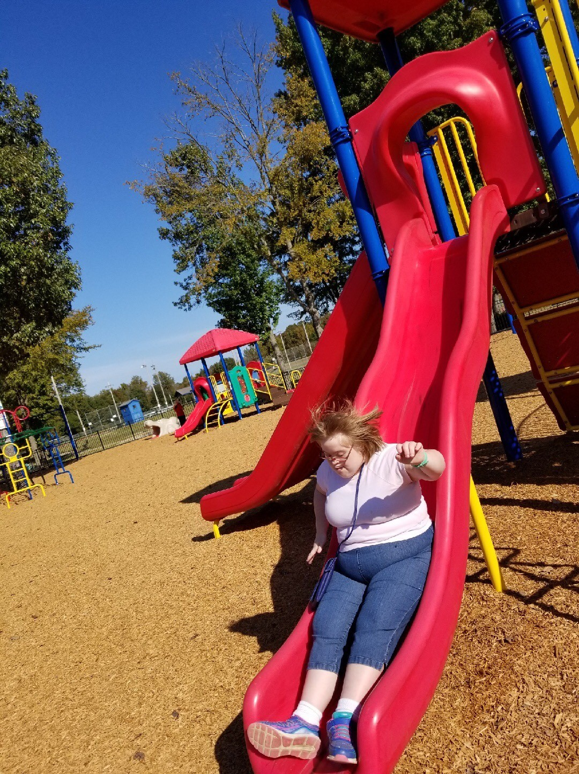
DSA LOVES the PARK

Slide 12
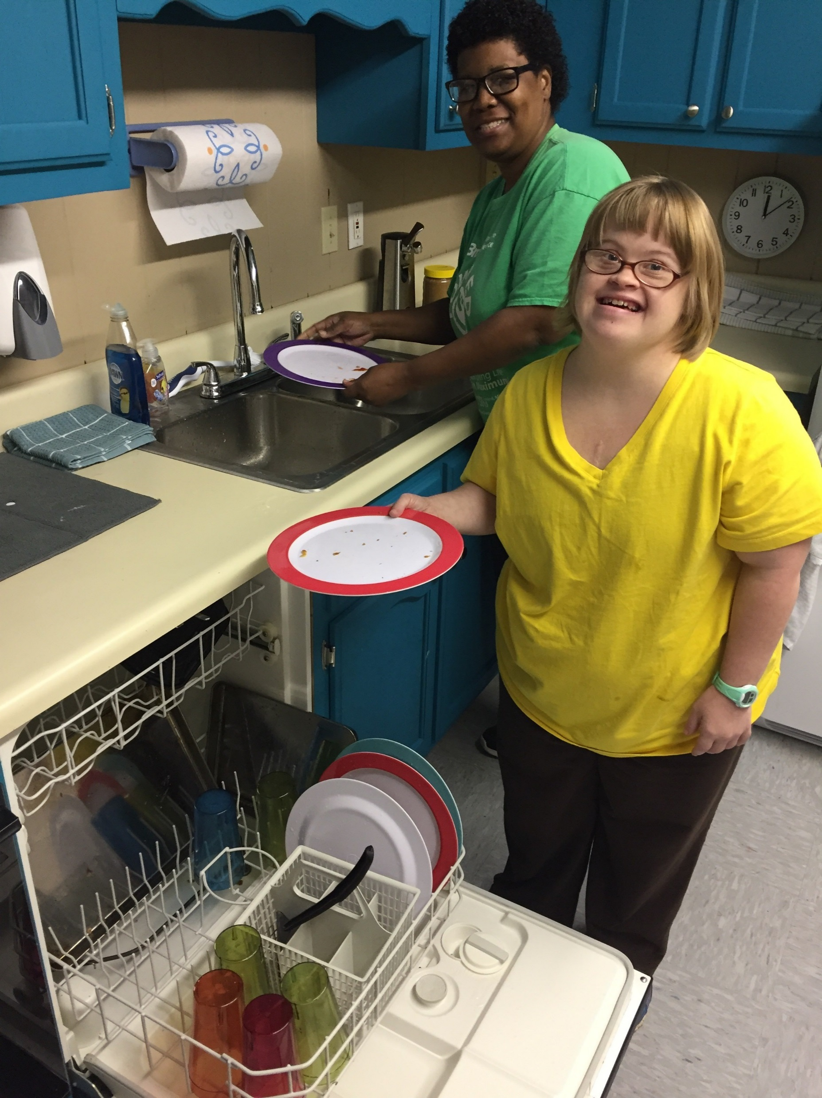
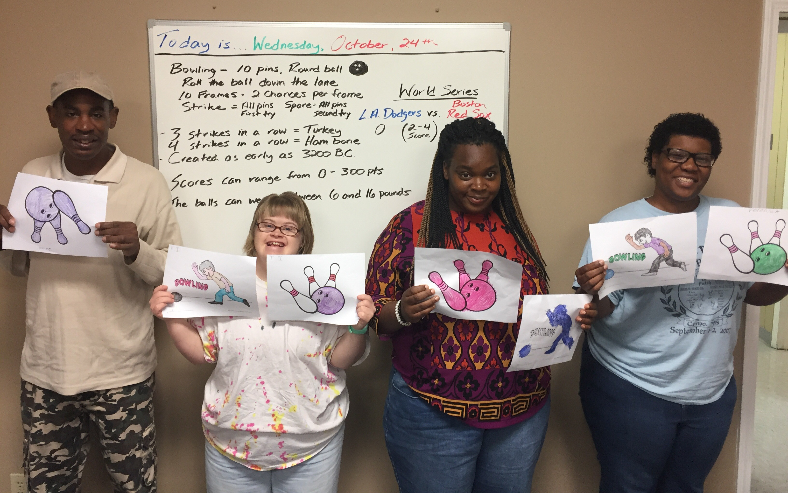
DSA LEARNING OPPORTUNITIES

Slide 13
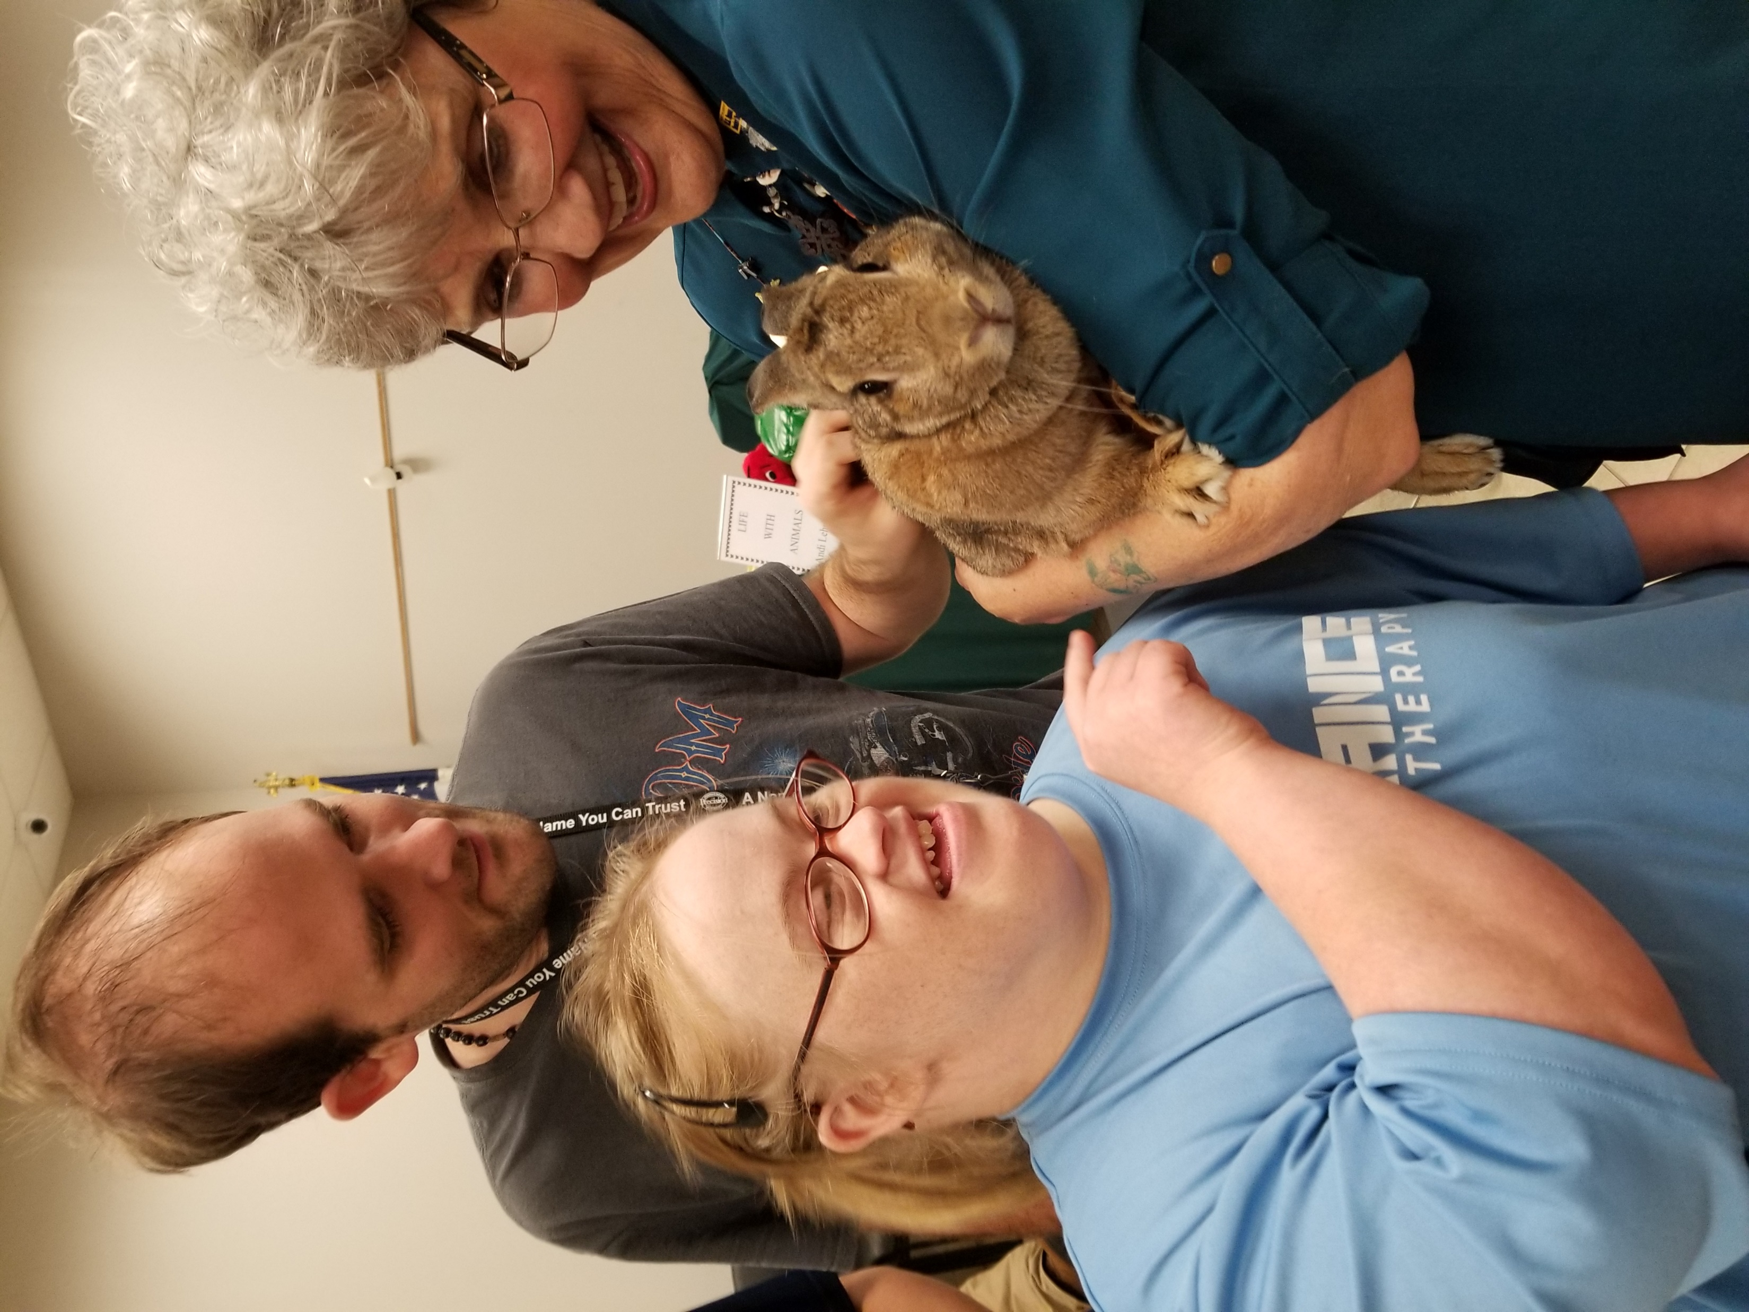
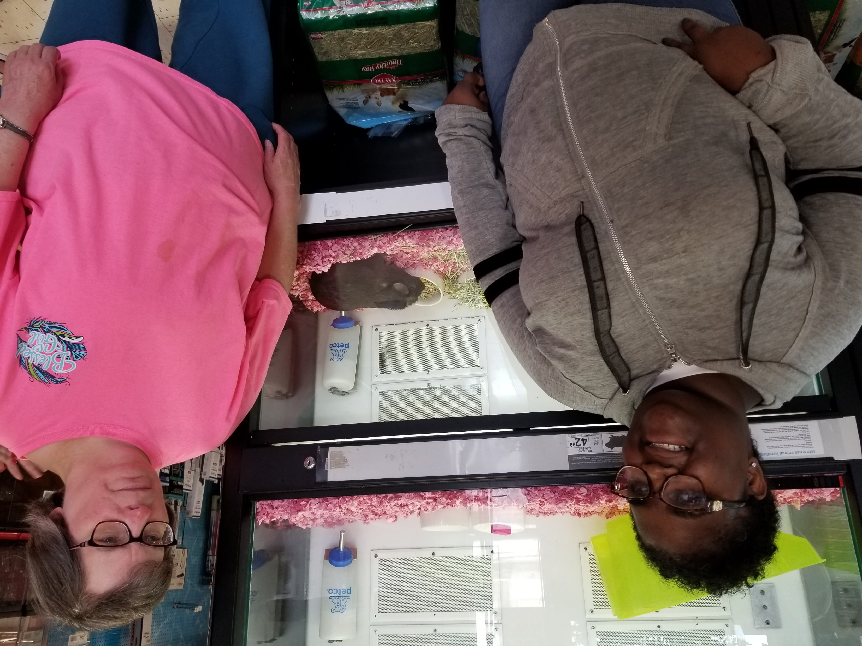
DSA LOVES OUR COMMUNITY

Slide 14
Supervised/Supported Living Services:
Supervised Living Services provide individually tailored supports to each person living in the home.
We seek to help persons develop, improve, and/or maintain the skills necessary for them to live happily and successfully in the community.
We shall design and offer activities to promote instruction, independence, and community participation.
Support levels and supervision enable persons to participate in activities of their choosing, a key contributor to experiencing a truly meaningful day.
Services are provided twenty-four (24) hours per day,
seven (7) days per week.

Slide 15
Supervised/Supported Living Services:
Personal care needs
Assistance with planning and preparing meals and snacks
Cleaning and doing laundry
Transportation
Assistance with mobility
Supervision of safety/security at all times
Banking and budgeting
Shopping for groceries and items a person needs/wants
Participation in community activities
Use of natural supports and typical community services available to the public
Social/leisure activities/events
Development of socially acceptable behaviors
Assistance with scheduling and attending appointments

Slide 16
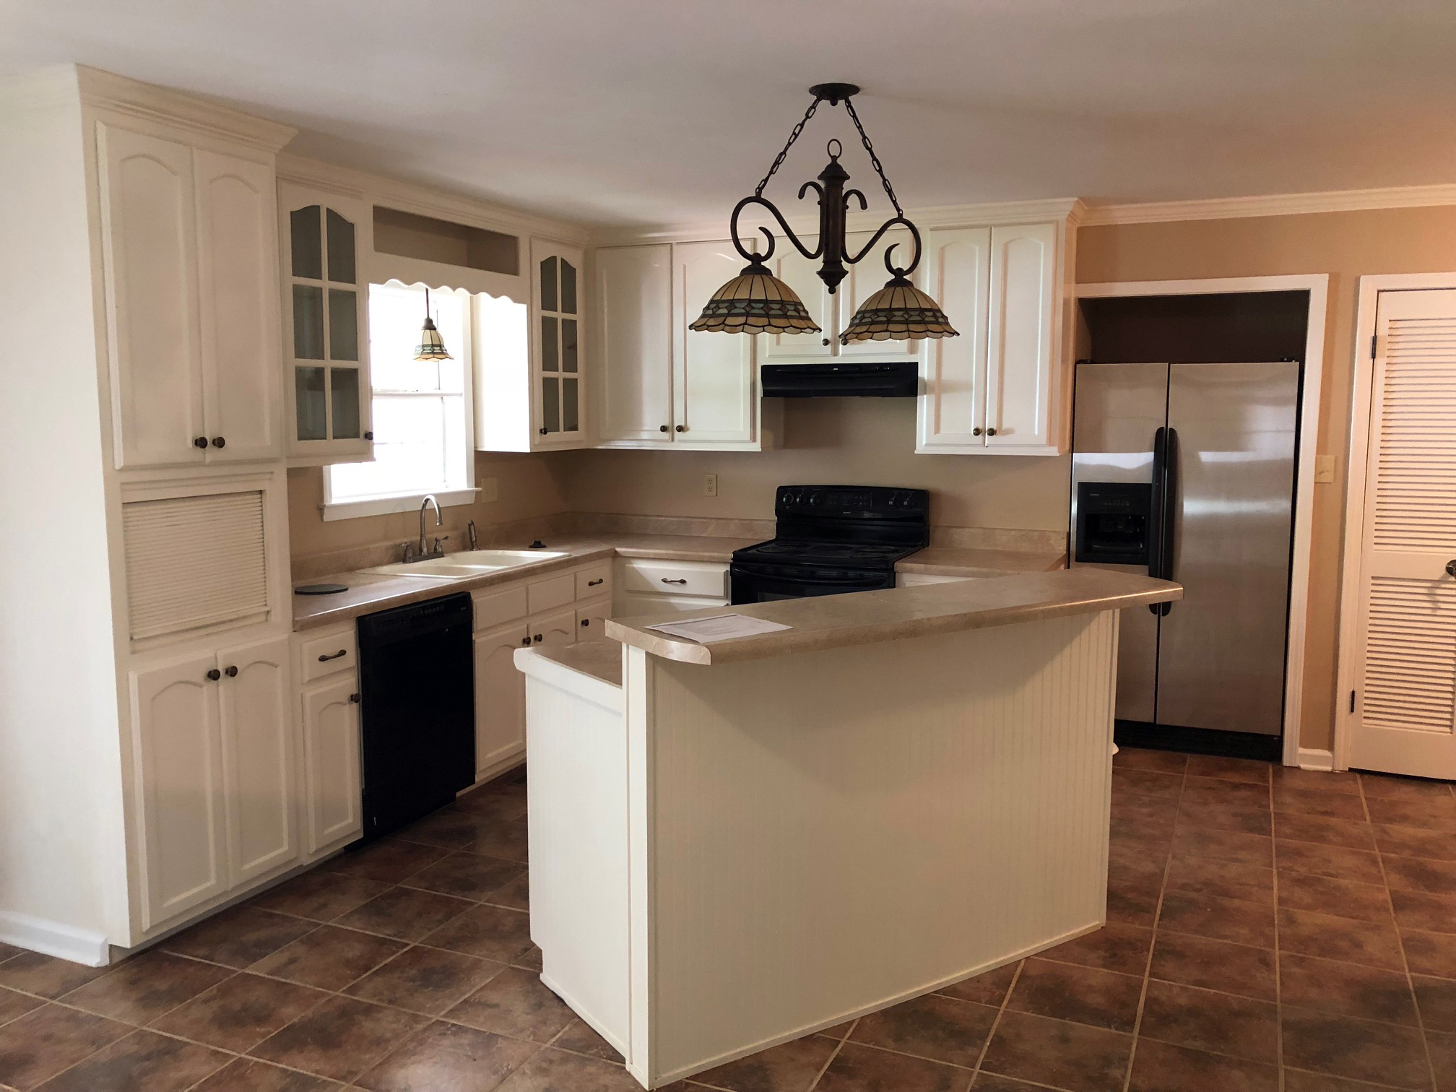
…The House on Tate Street… Supervised/Supported Living Service Officially opened on July 1, 2019

Slide 17
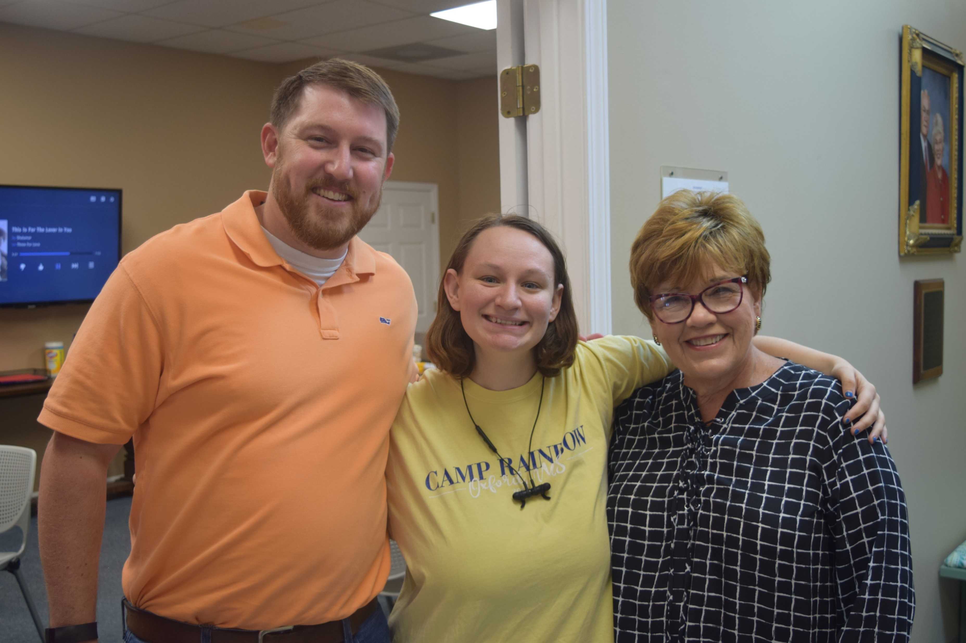
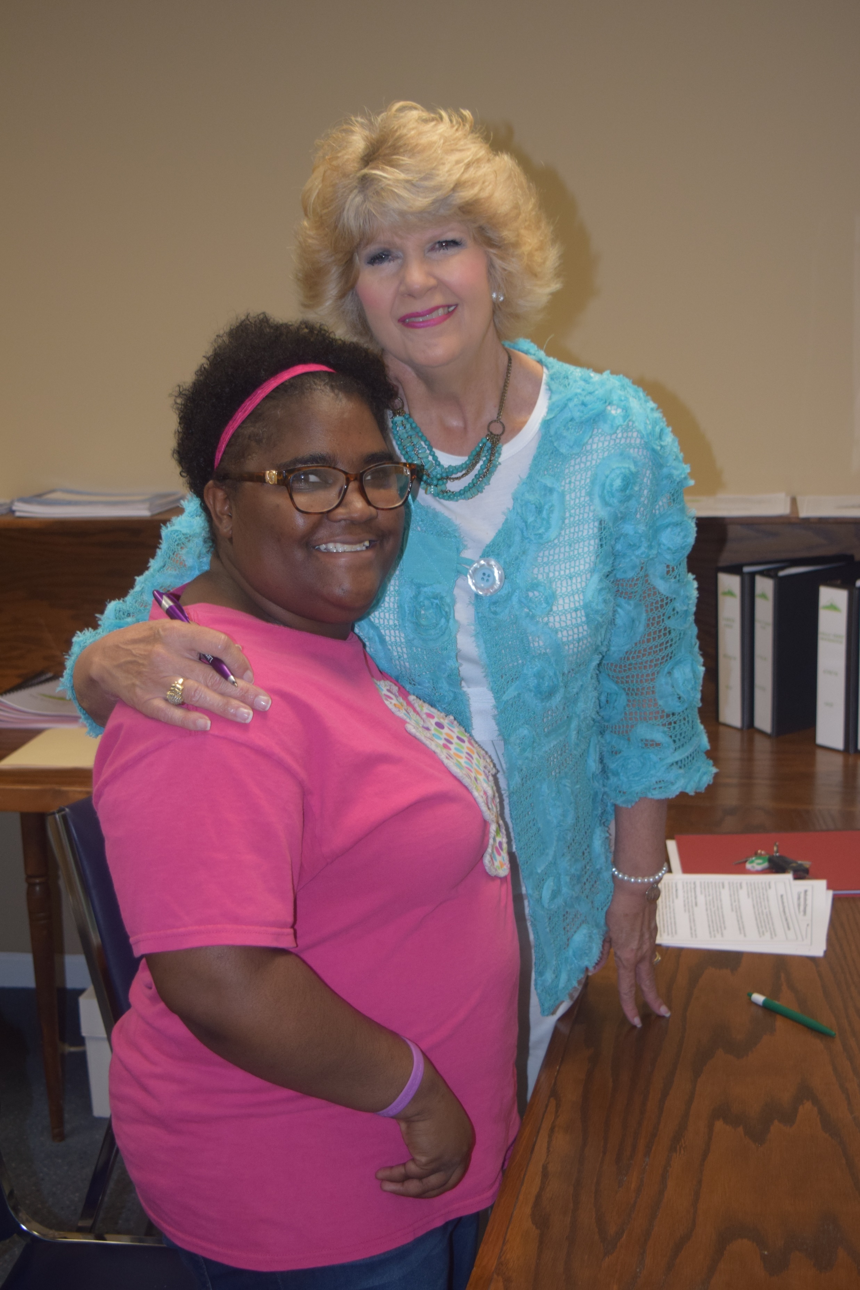
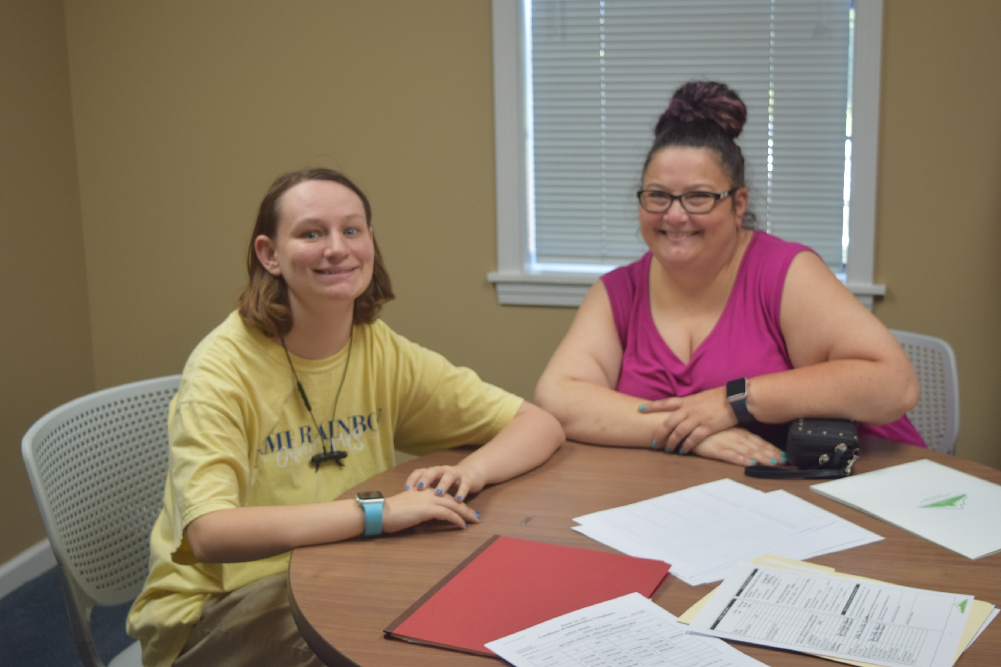
The Admissions process…the State requires a lot of paperwork!!!

Slide 18
Move in Day – July 1, 2019
Admission papers
Rental agreement
Meeting with the nurse
My key
Setting up a bank account

Slide 19
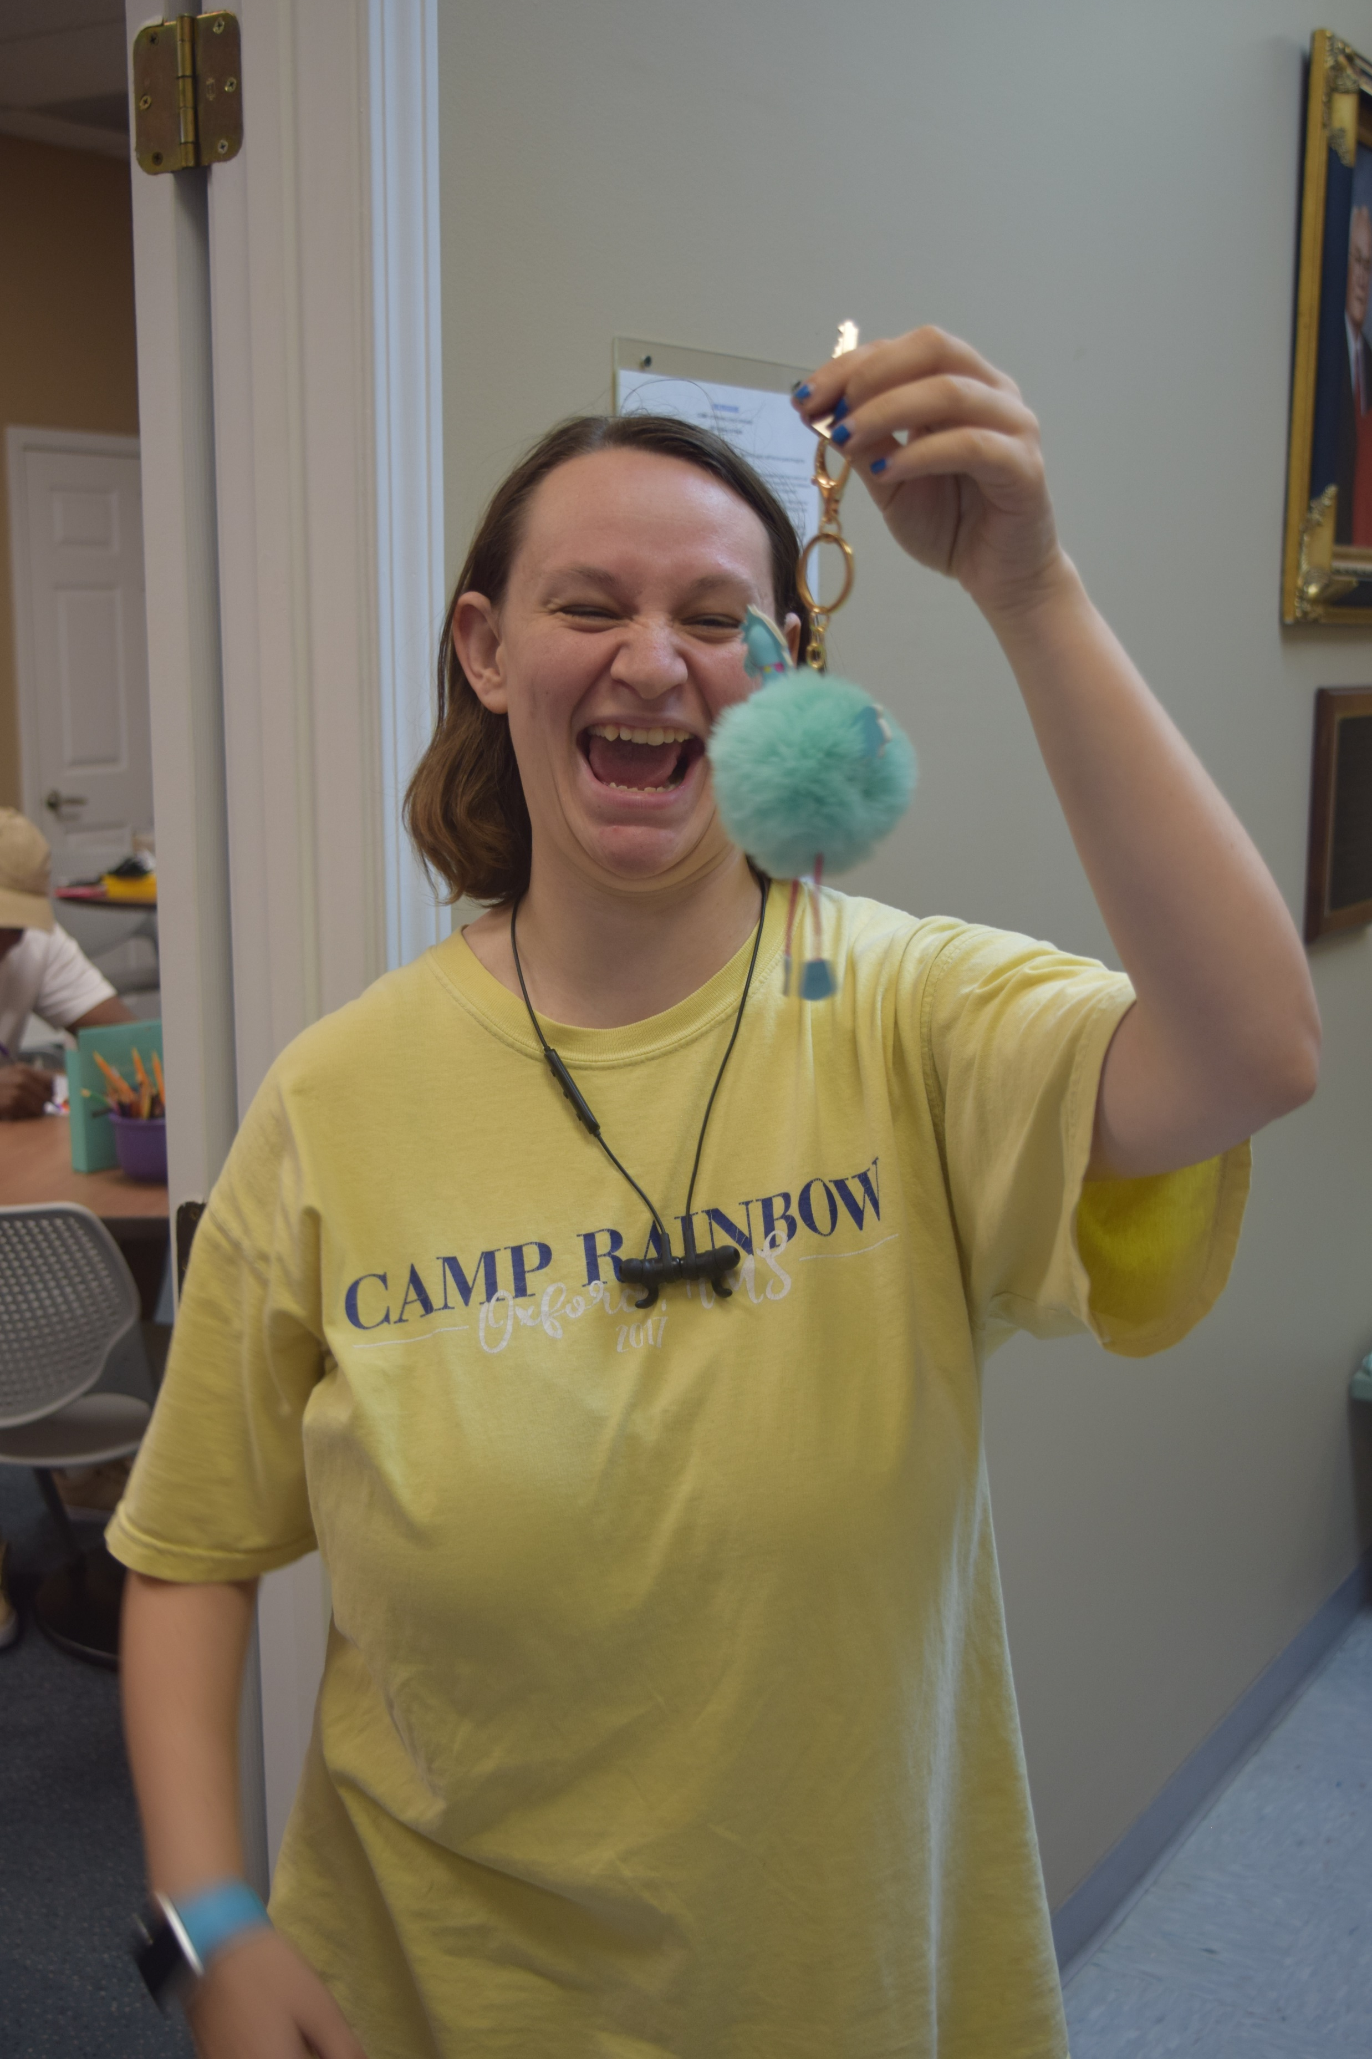
The Key to My House

Slide 20
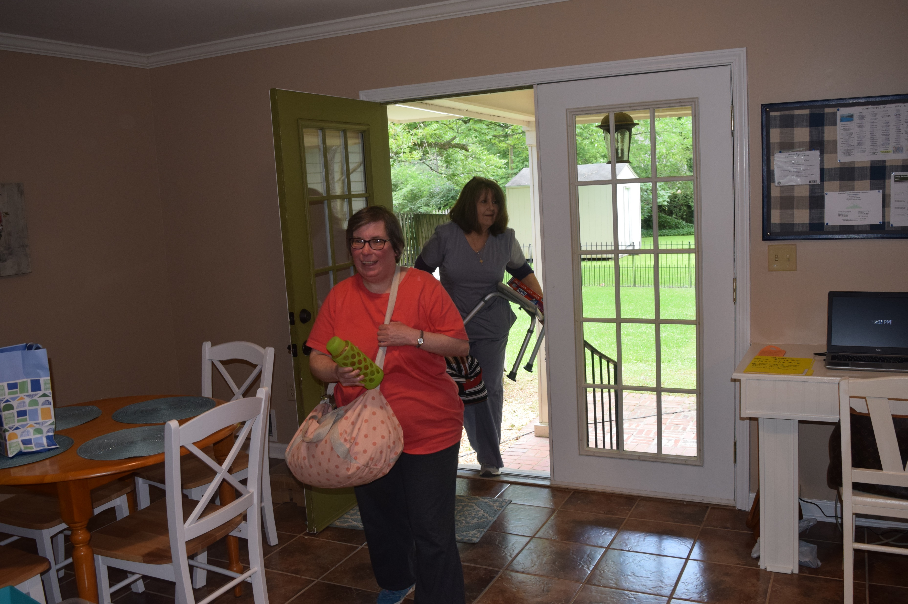
Moving In

Slide 21
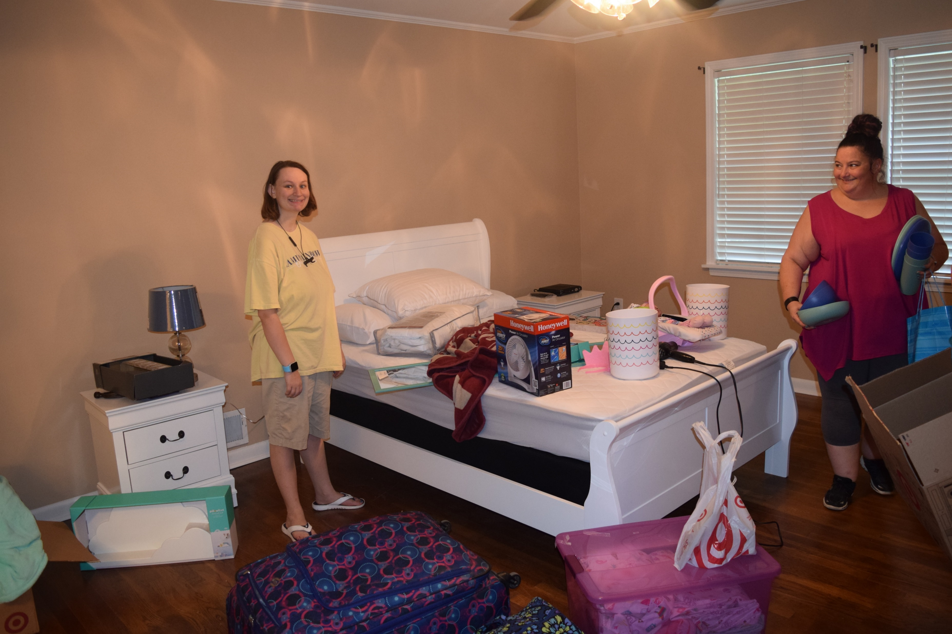
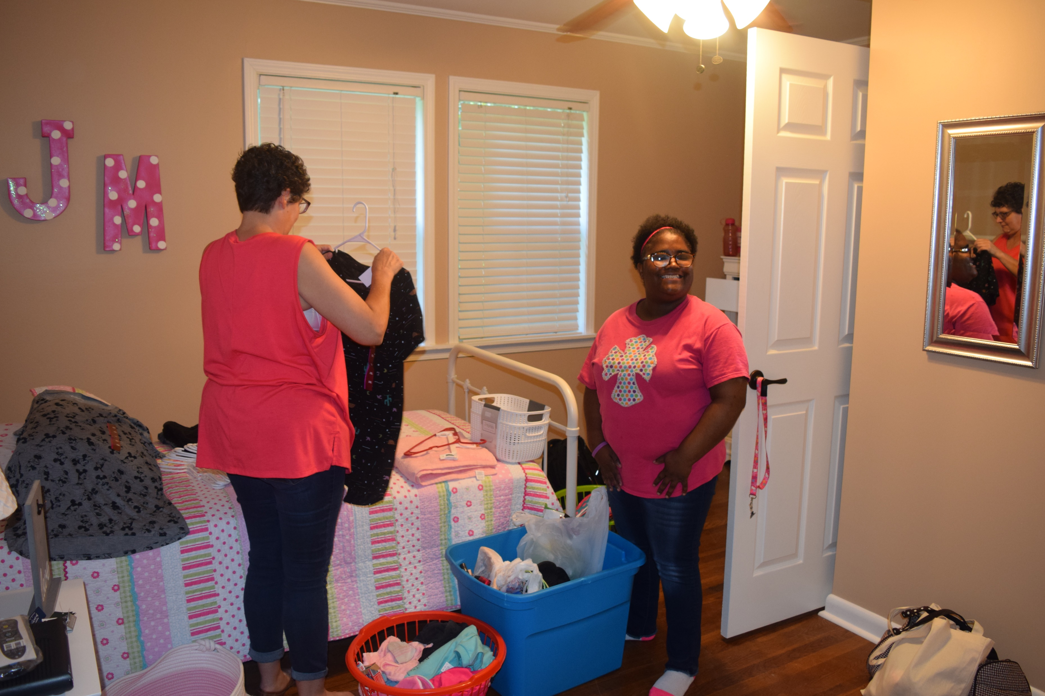
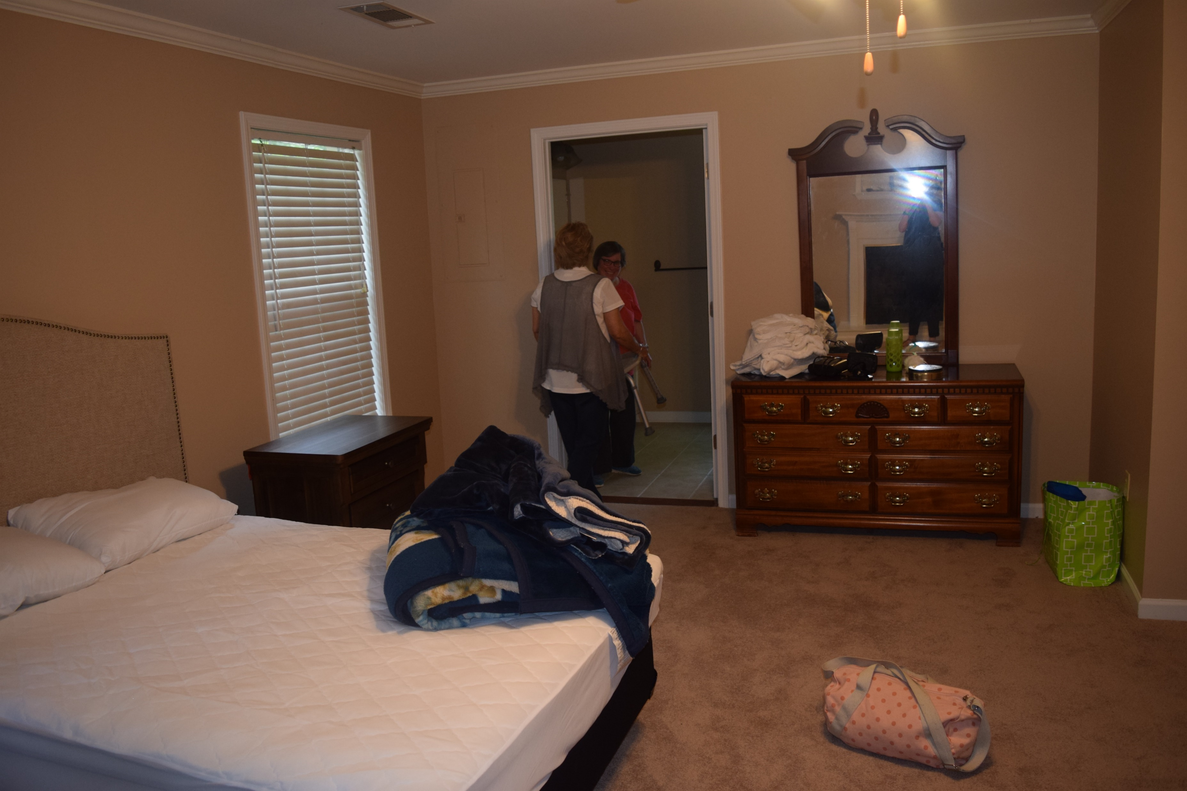
Do you think I have enough stuff?

Slide 22
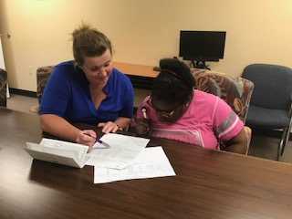
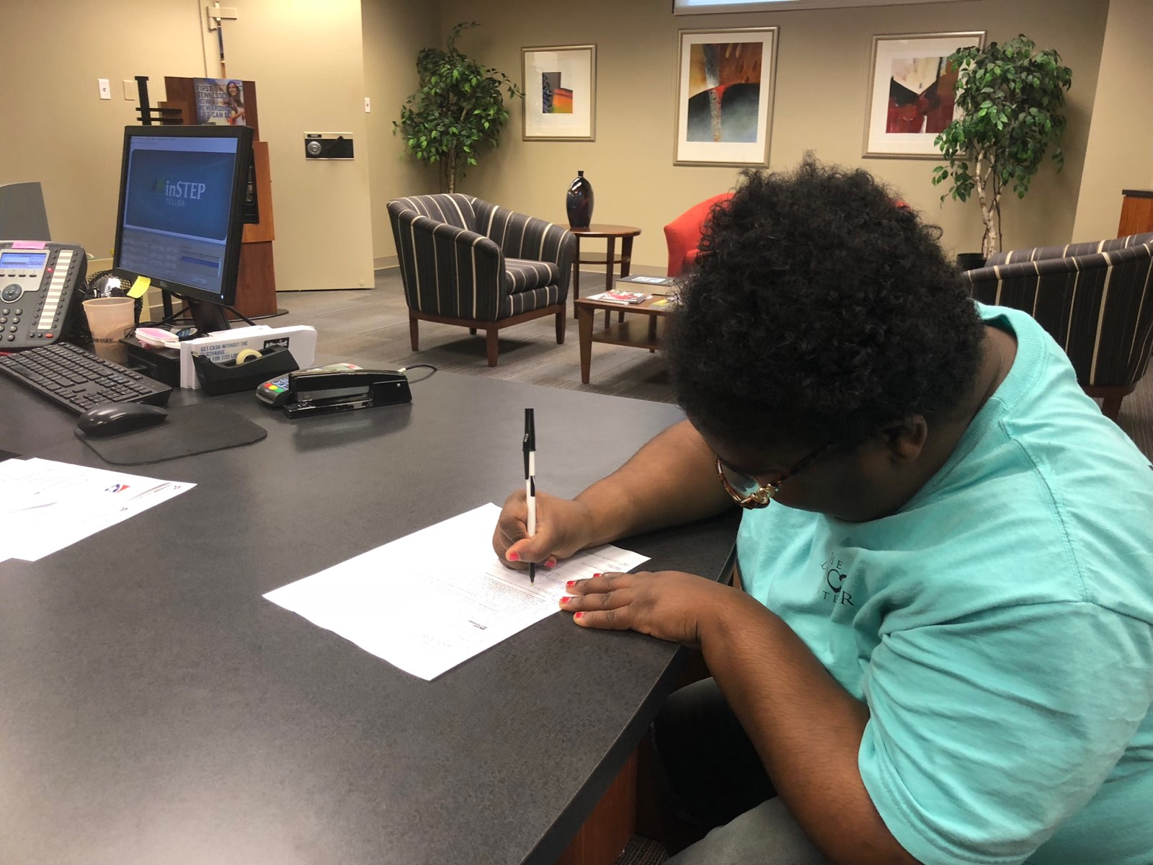
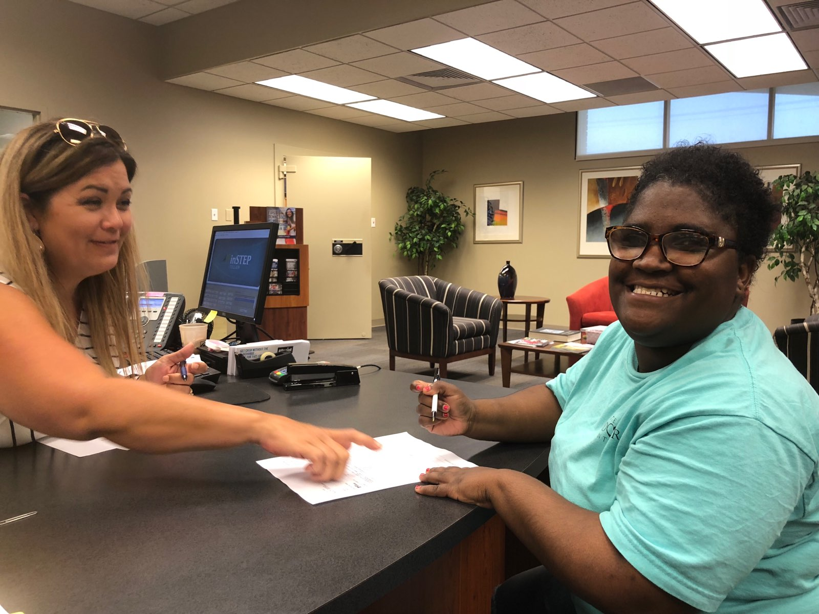
Opening my first Bank account and learning to budget!!!!

Slide 23
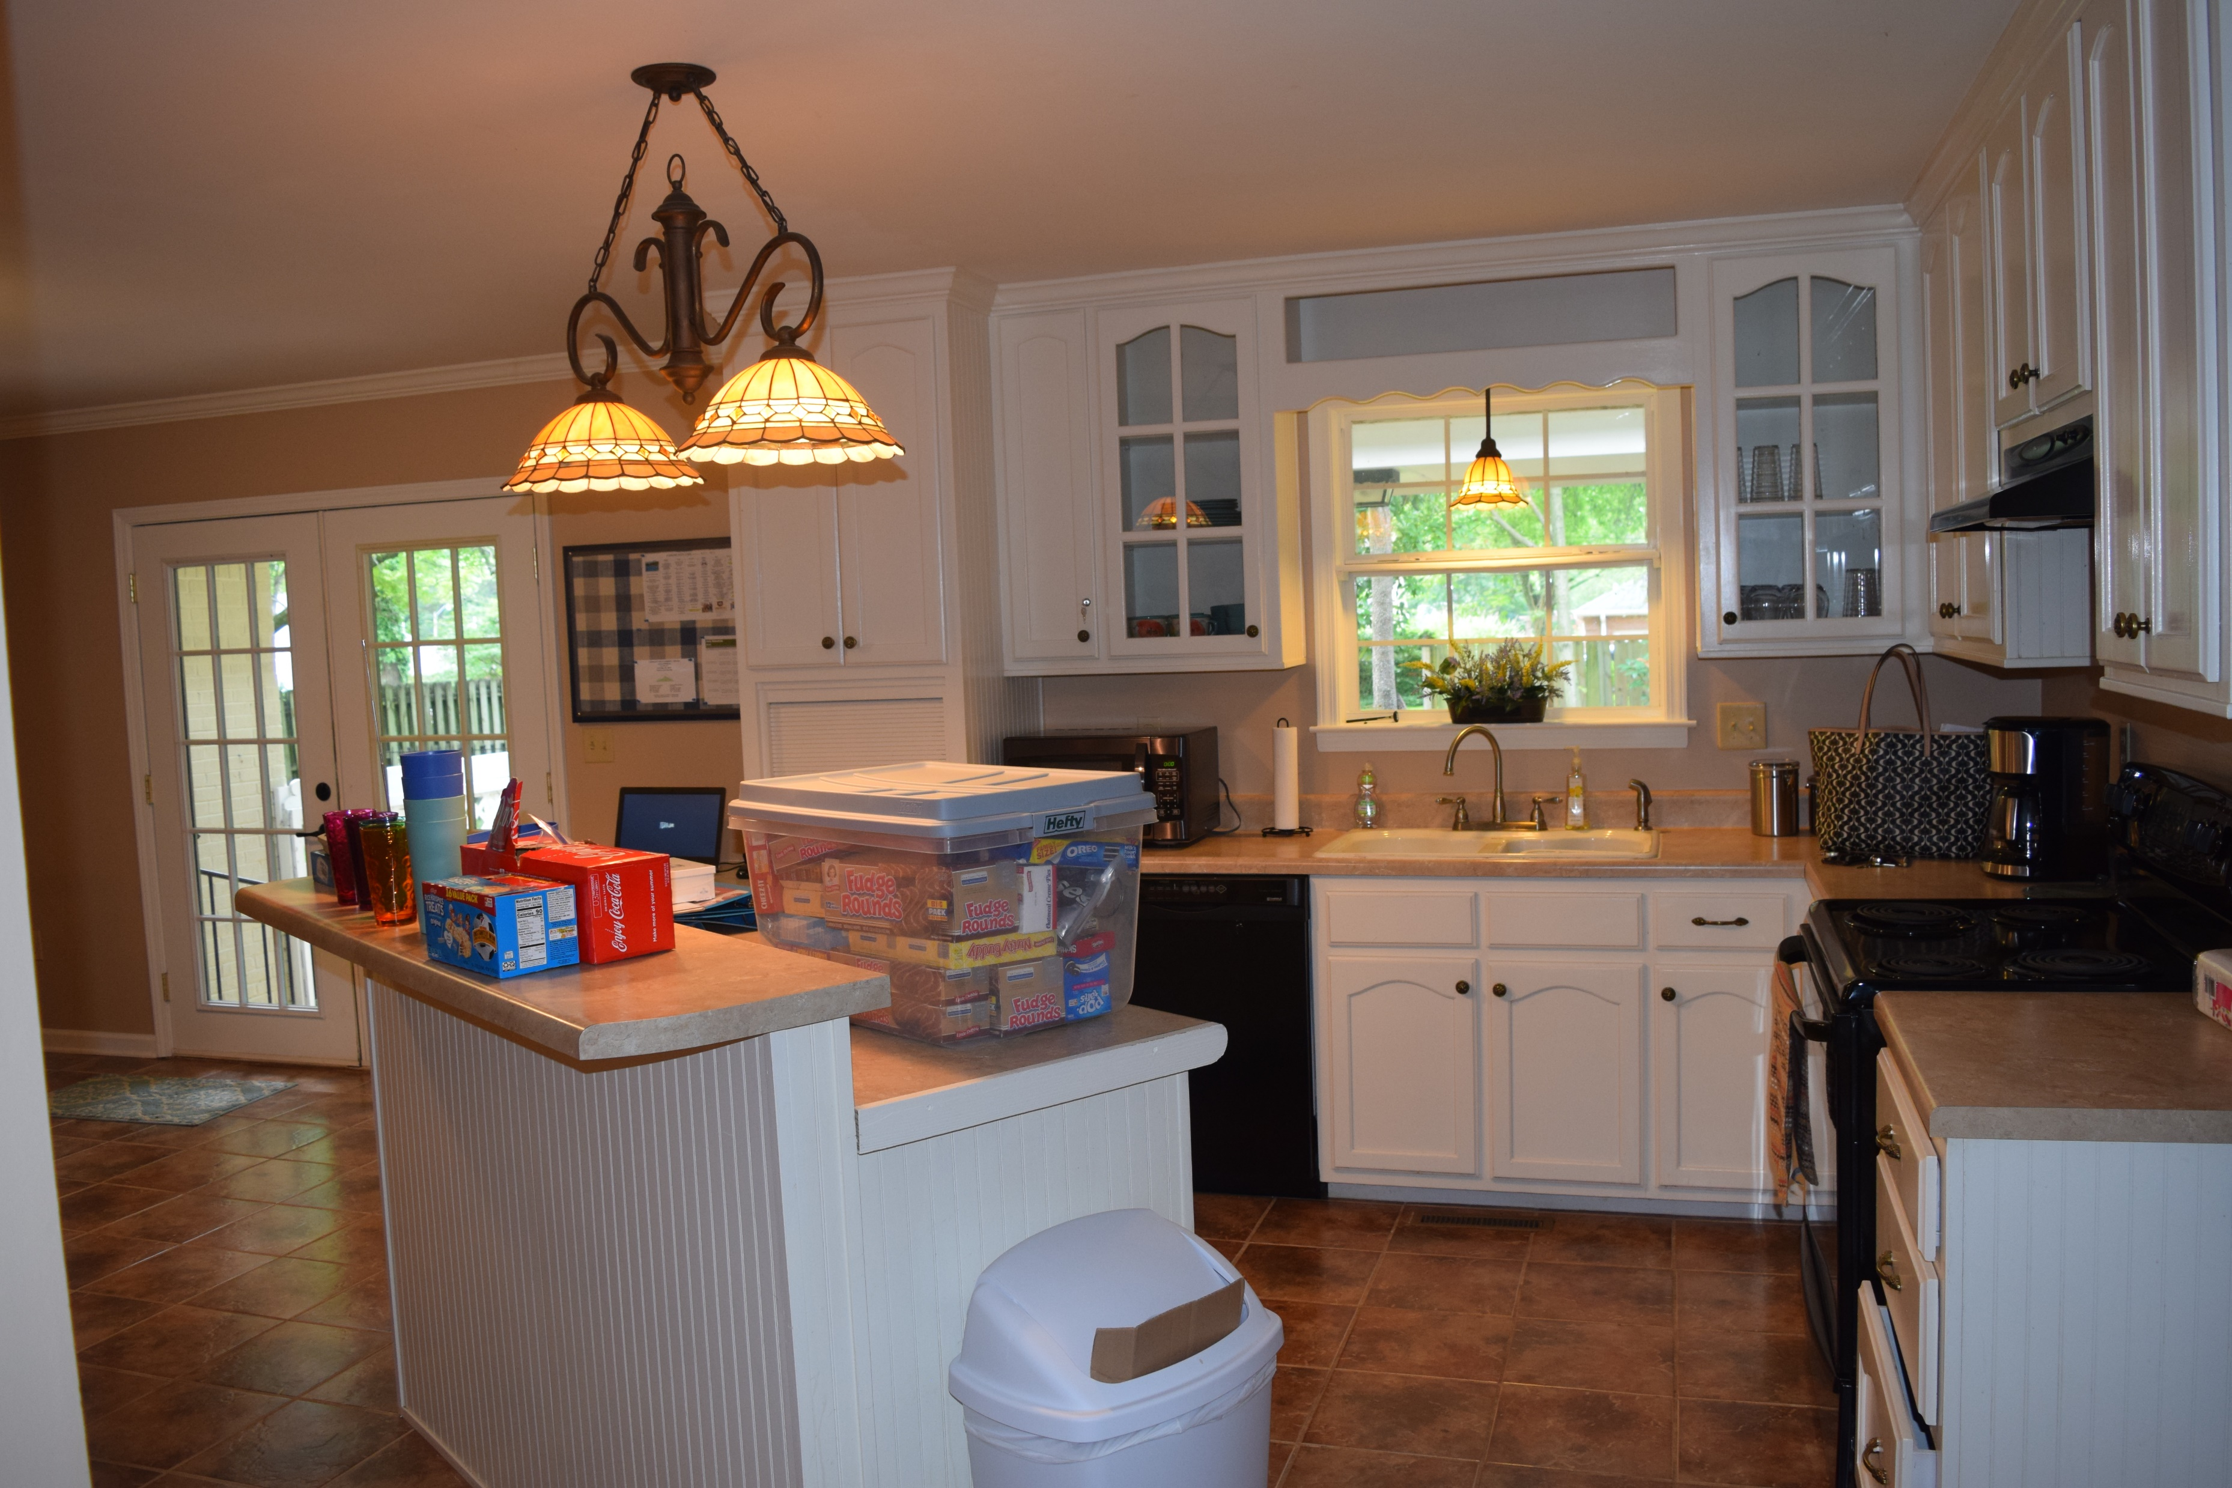
…we can’t forget my snack box…

Slide 24
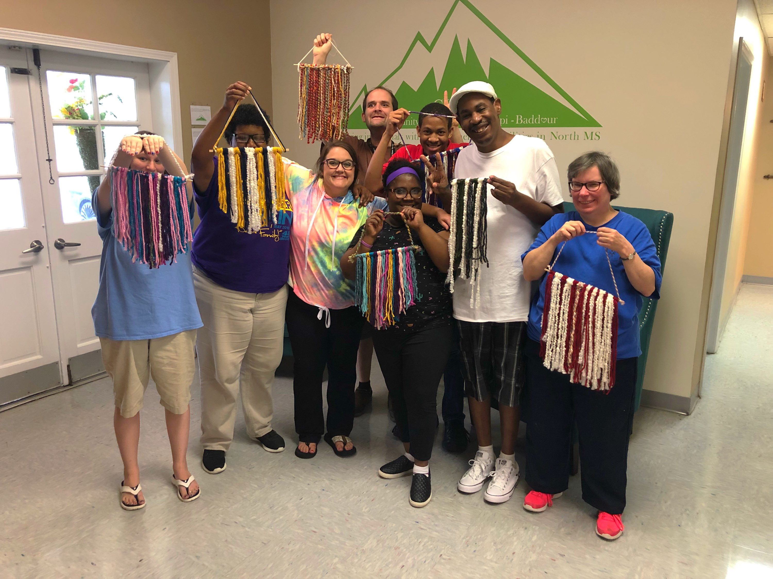
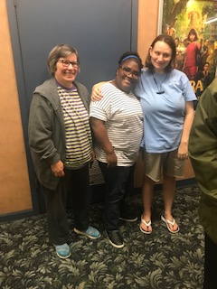
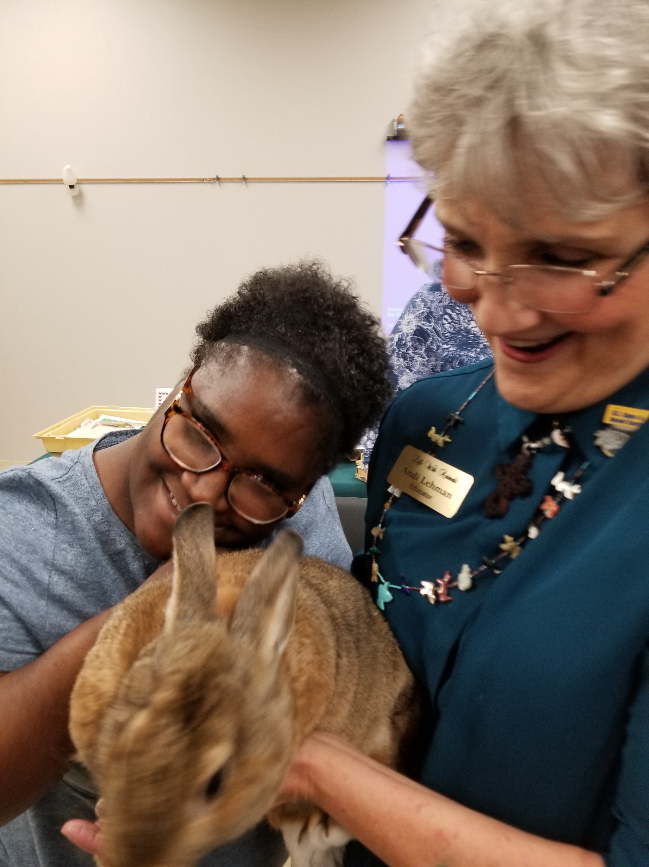
We’ve been busy with music, art, swimming, shopping, movies, the park, pet store, ice cream parlor, paint parties, grocery shopping, library, computer lab, Chapel, and more…in only 3 ½ weeks

Slide 25
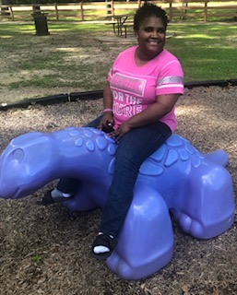
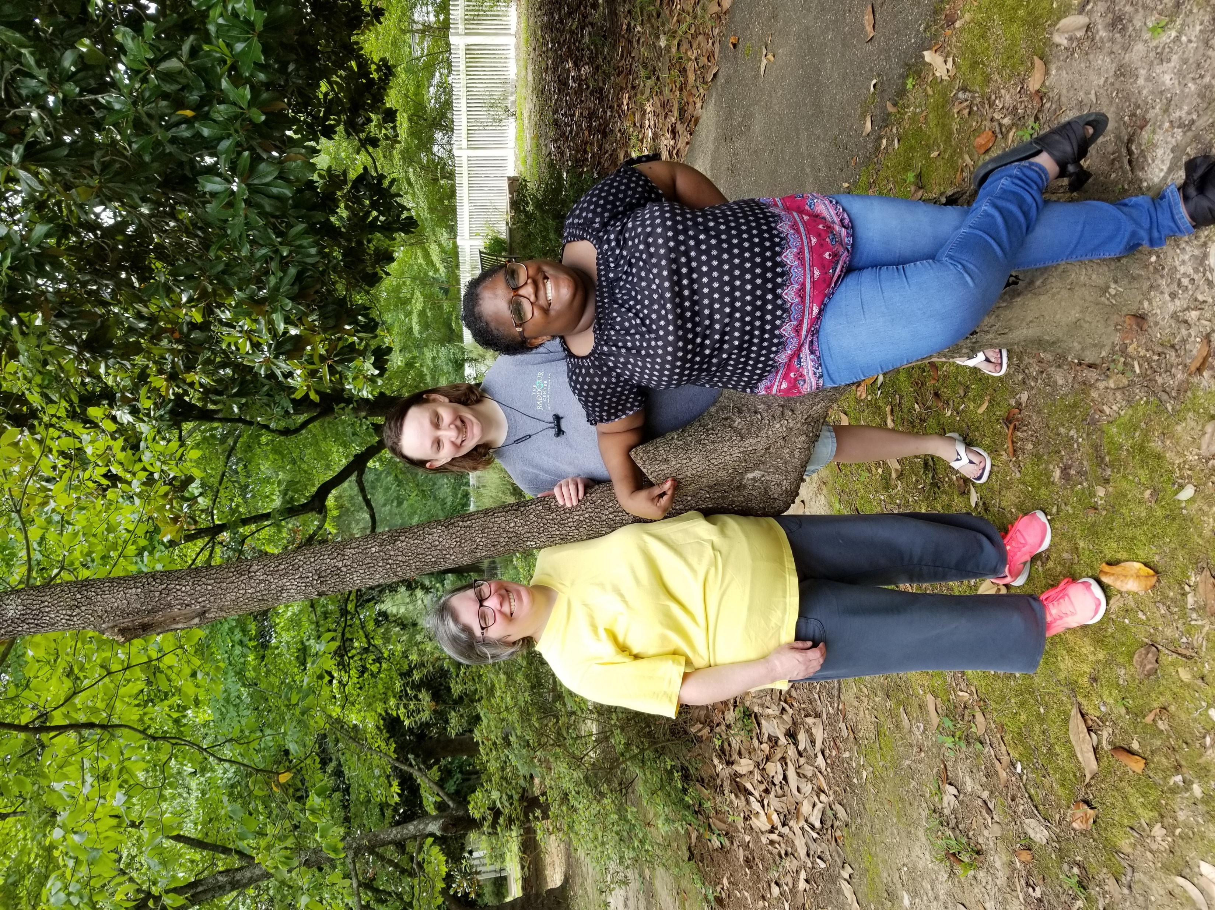
…fun, fun, and more fun…

Slide 26
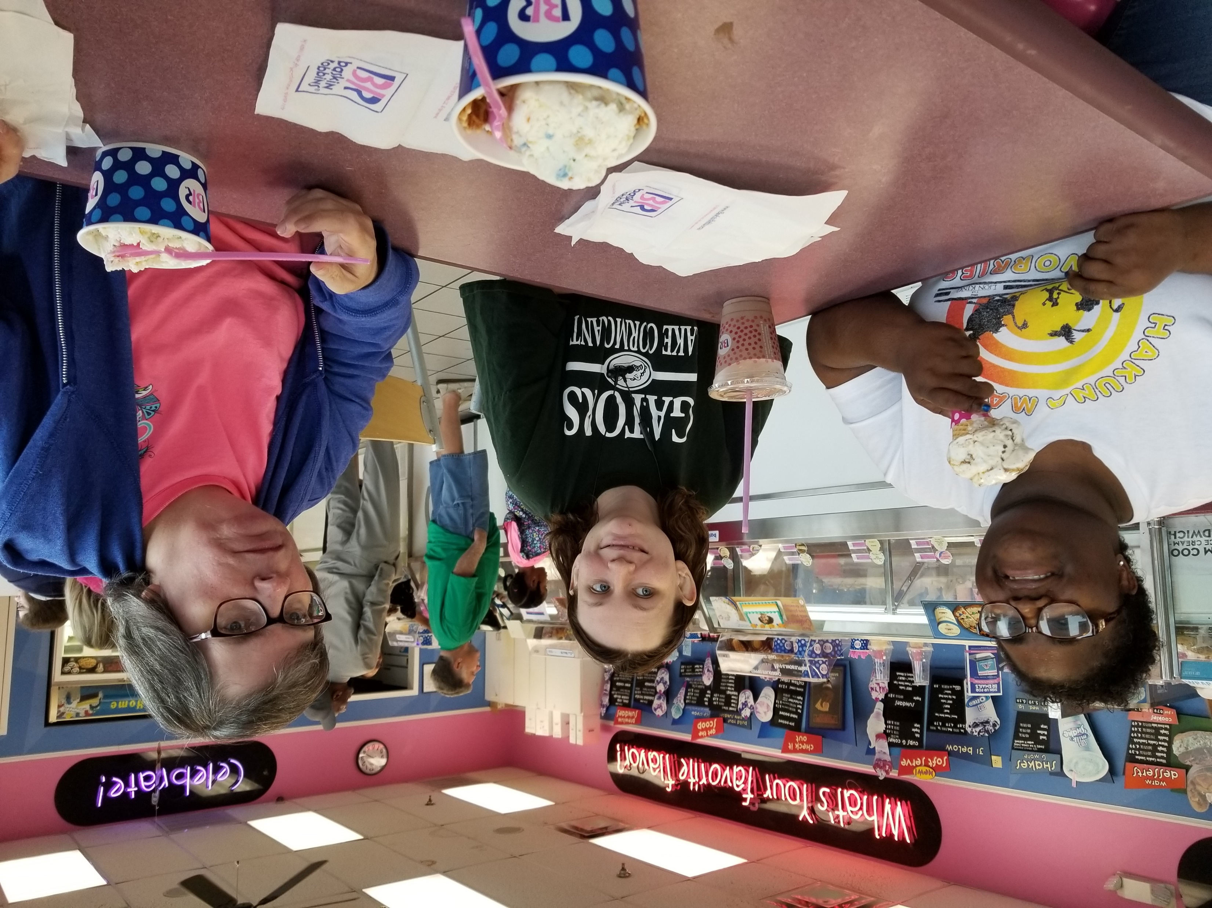
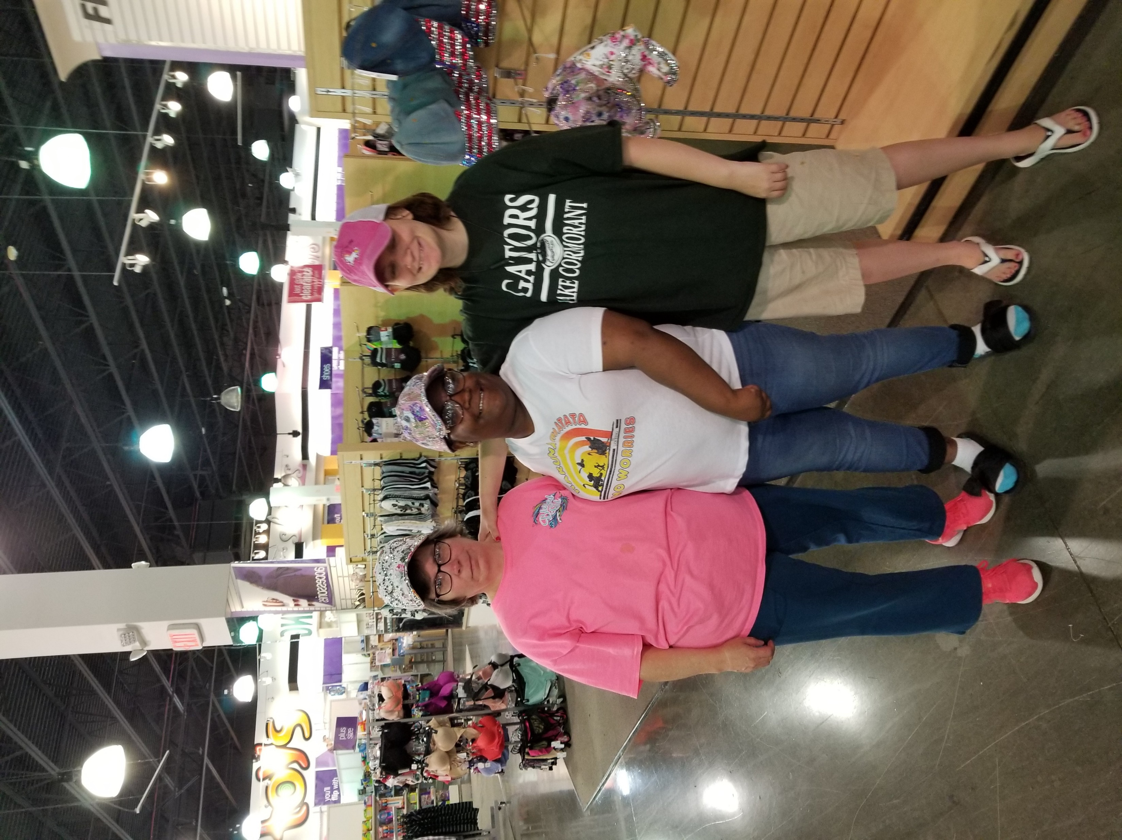
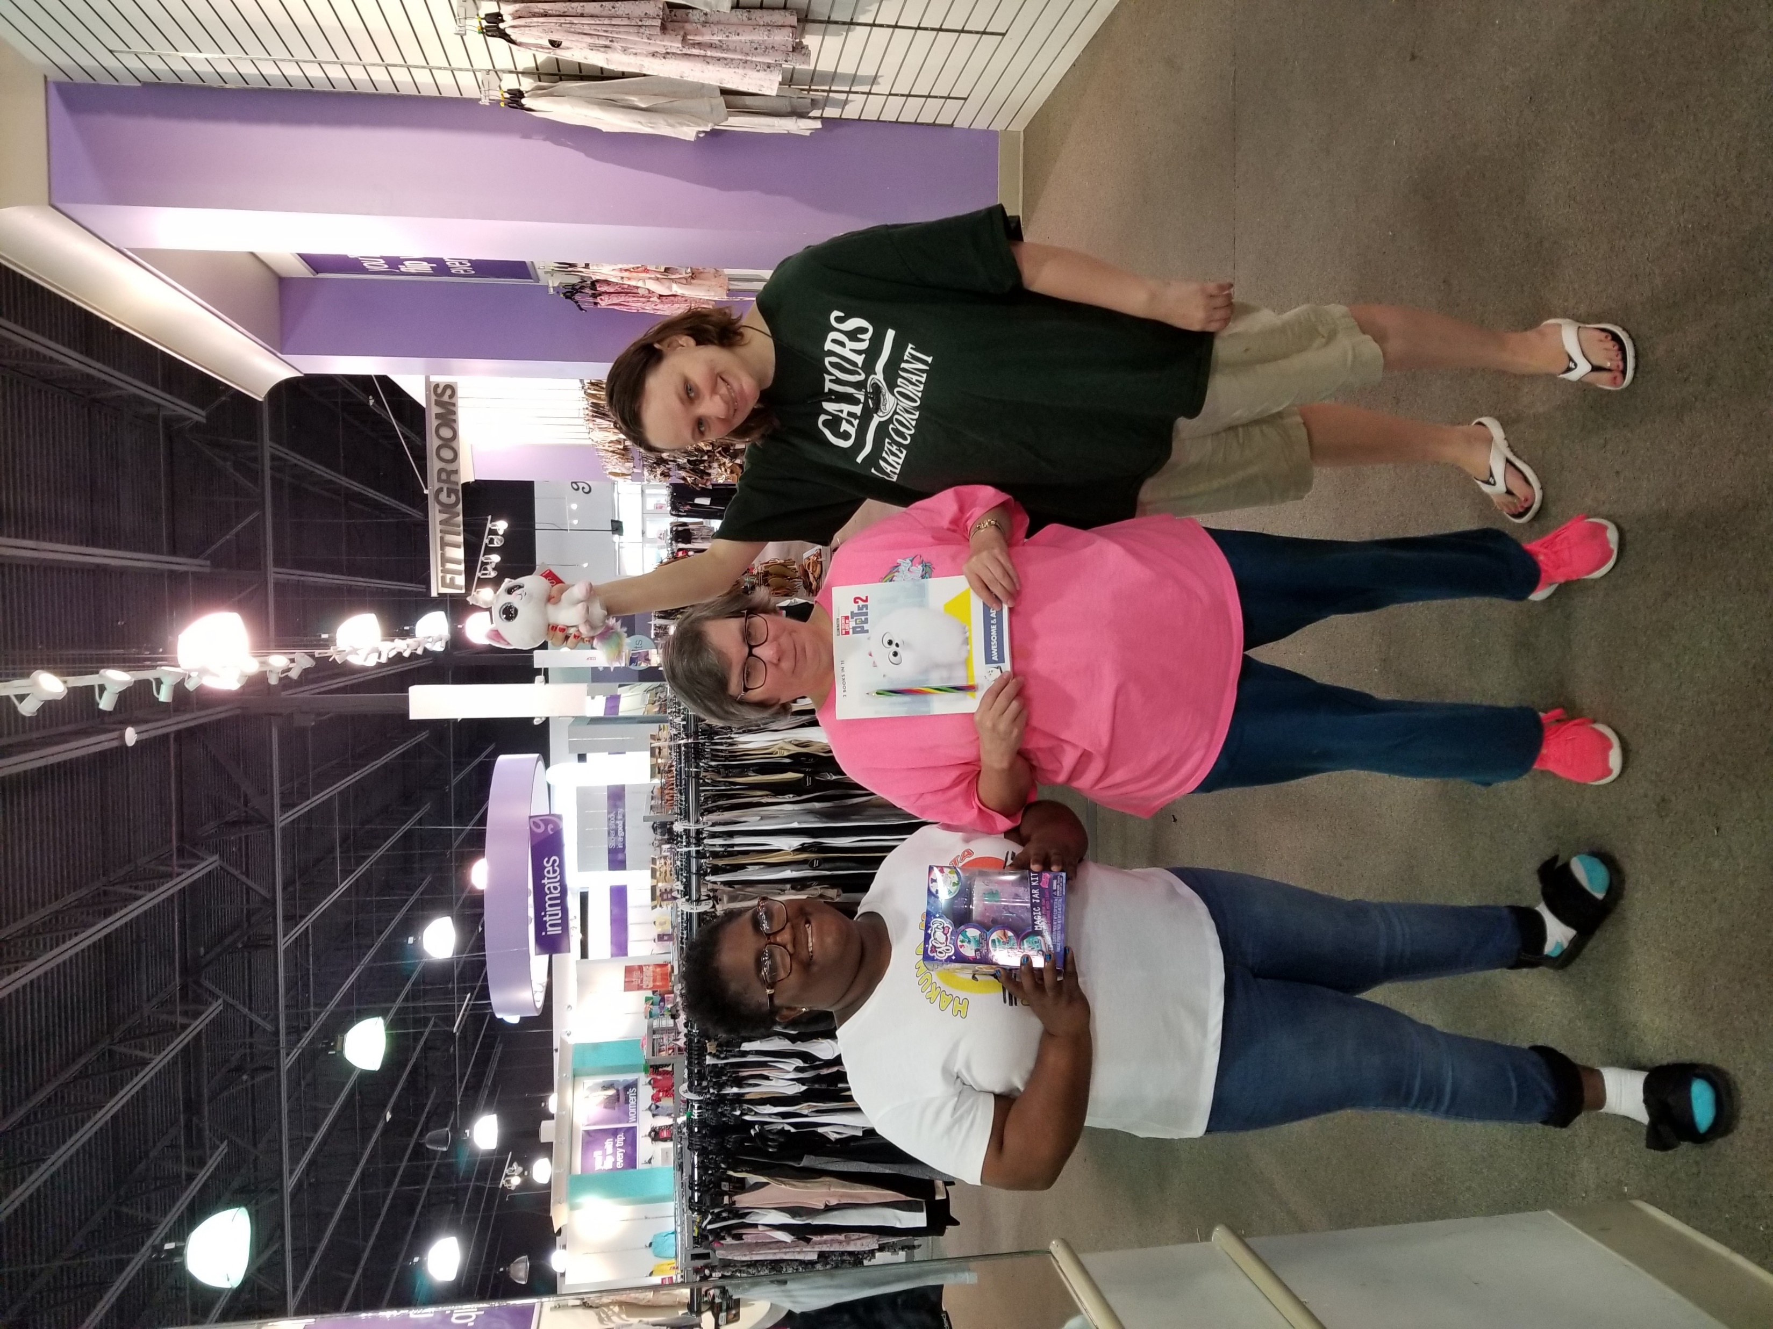
Saturday Shopping Shenanigans

Slide 27
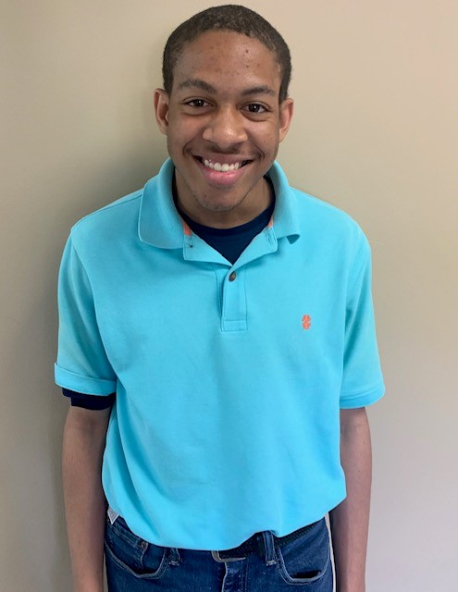
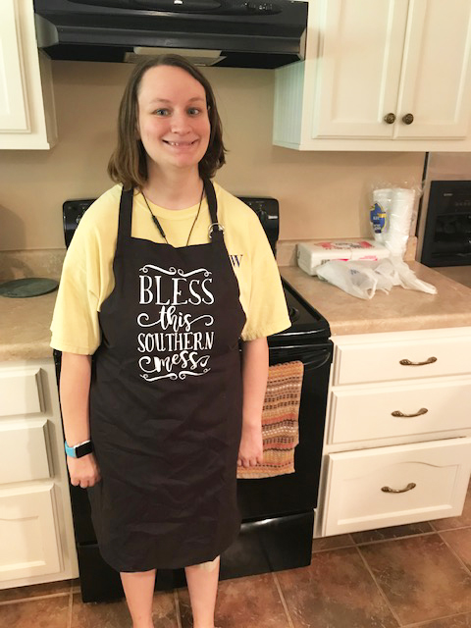
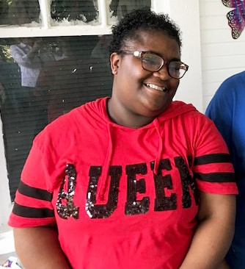
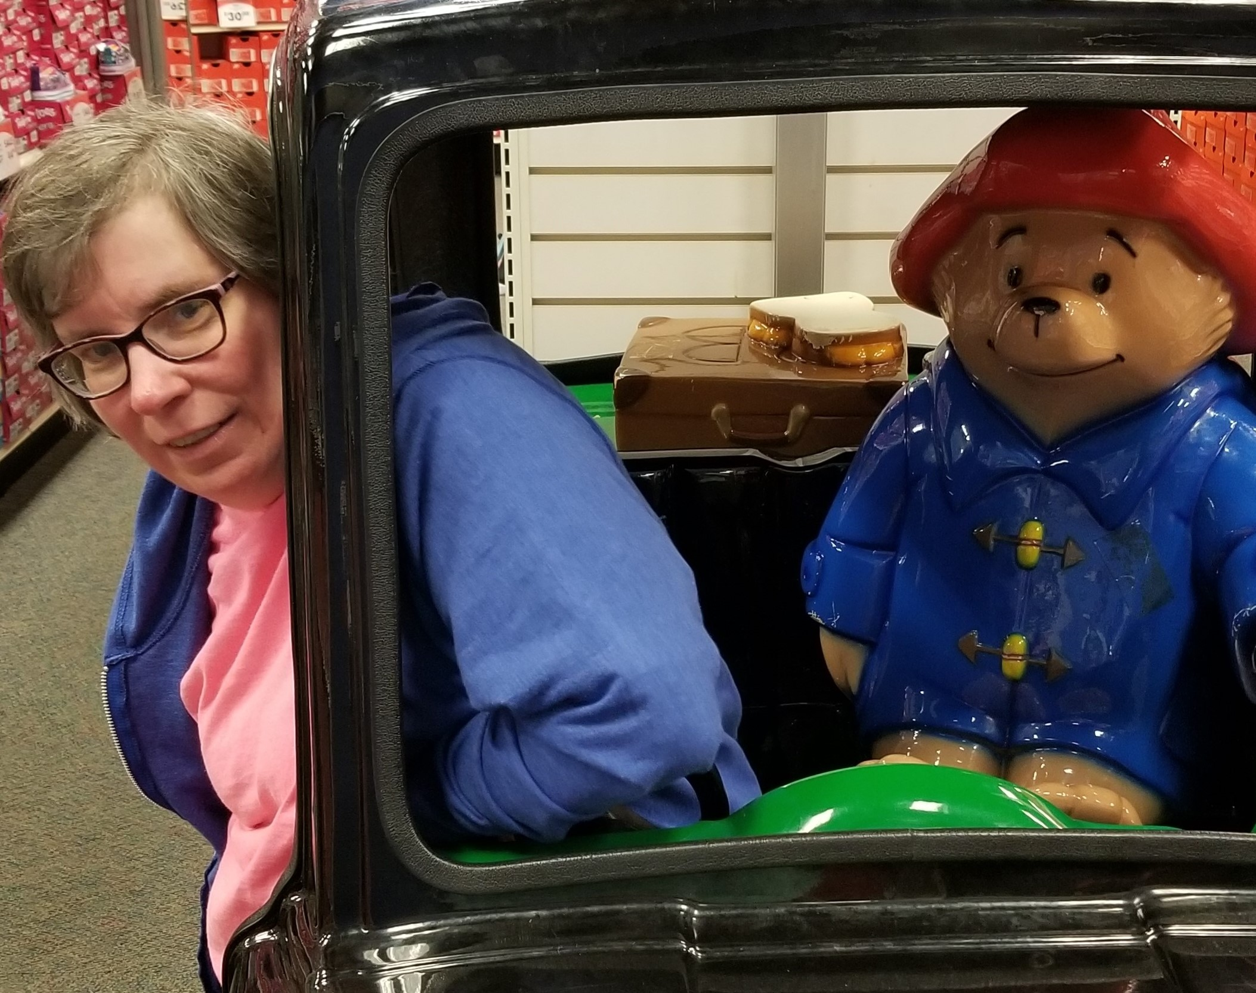
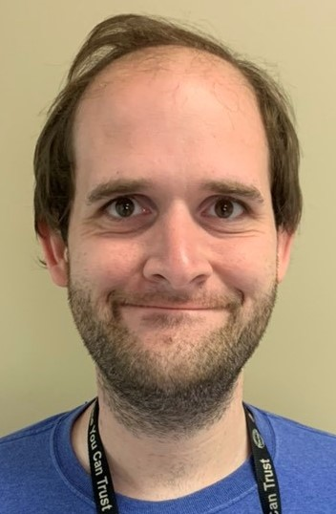
Thank You to the Board of Trustees for supporting us to live our “best” life! CLIMB is building upon our wishes and abilities while you apply your expertise, heart and support!

Slide 28
…more to come but for now… CLIMB is…

Slide 29
Connect with CLIMB
On the Web: www.climbms.org
By Email: climb.mississippi@gmail.com
By Phone: 662-689-0501

